Slide 1
Real Estate & Rental Infographics
Gordon Oboh

Slide 2
Methodology Overview
1
Outlier Removal Using the Interquartile Range (IQR) Method; Price, Square Footage, Bedrooms and Bathrooms
2
Excluded Property listings outside the Continental United States.
3
Dataset was scraped on January 2020
Notes:
Slide Title: Data Cleaning and Methodology Overview
Bullet Points:
Outlier Removal Using the Interquartile Range (IQR) Method:
Variables Cleaned:
Price
Livable Area (Square Feet)
Number of Bedrooms
Number of Bathrooms
Purpose:
To eliminate extreme values that could skew the analysis.
Ensures a more accurate representation of typical rental properties.
Geographic Scope Refinement:
Excluded Properties:
Listings outside the Continental United States.
Reason:
To maintain consistency by focusing on the primary U.S. rental market.
Excludes areas with different market dynamics (e.g., Alaska, Hawaii).

Slide 3
Rental Composition
Distribution
Distribution
Correlation
Rental Type
Distribution
Bathrooms & Bedrooms
Boxplot
Property Size vs Pricing
Property Size & Price
Property Size & Price

Slide 4
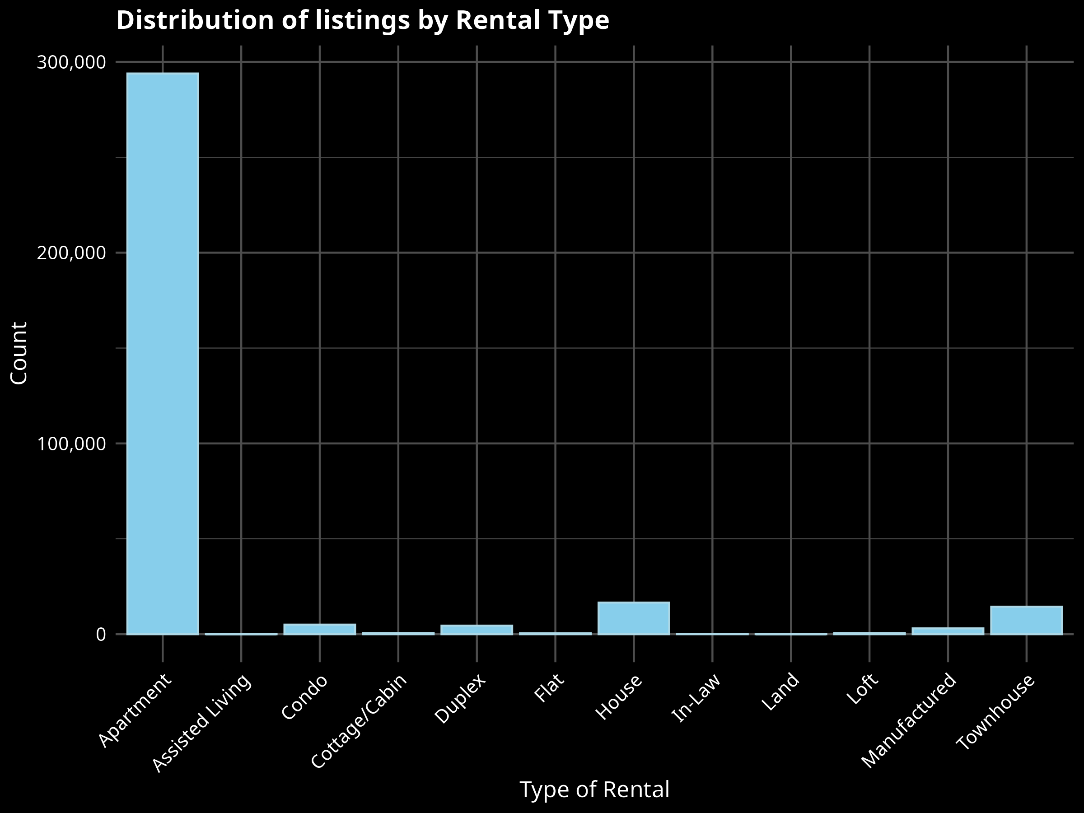
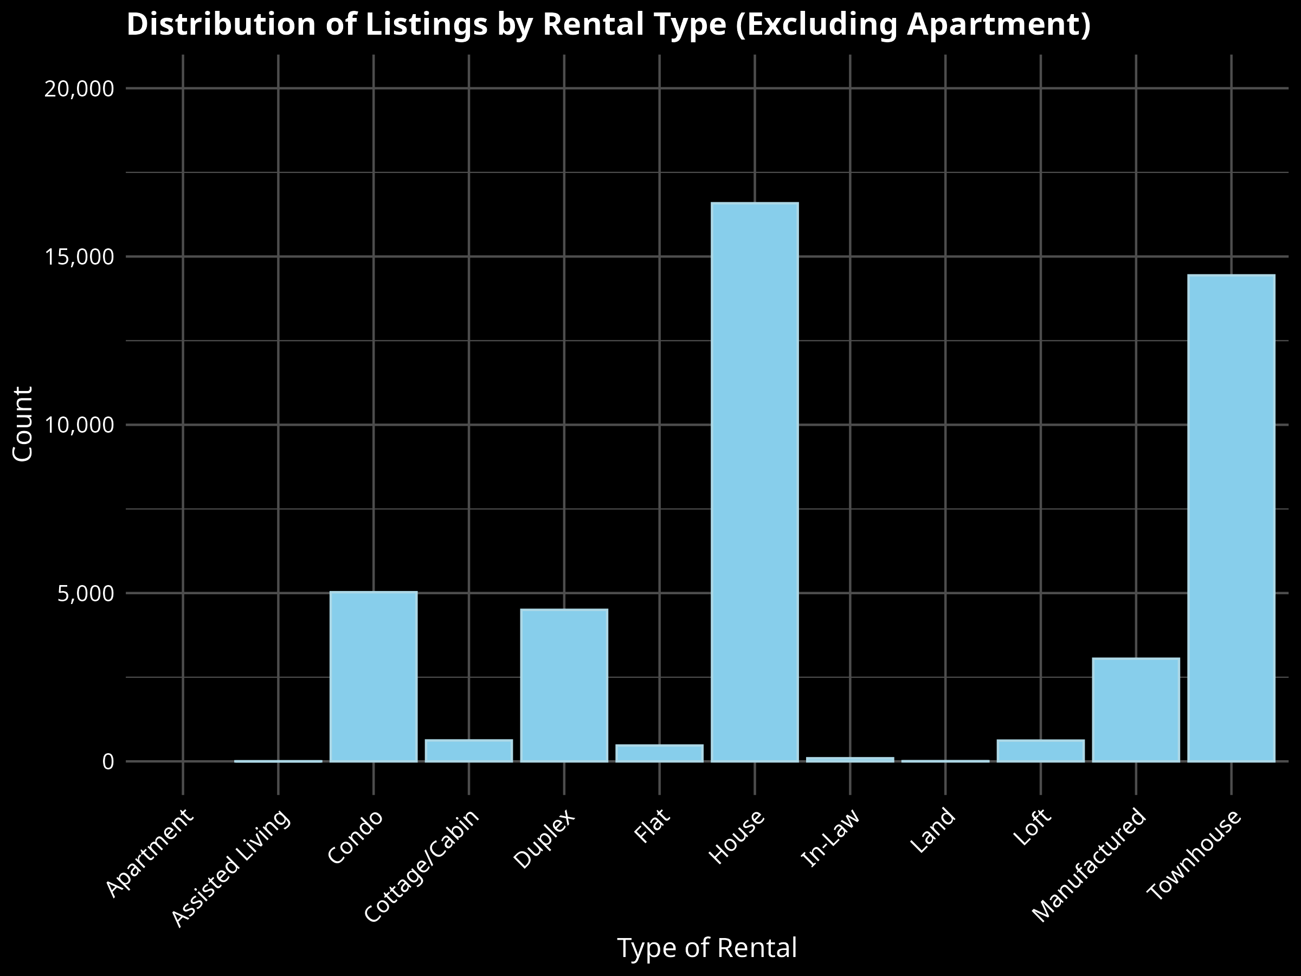
Rental Composition: Rental Types

Slide 5
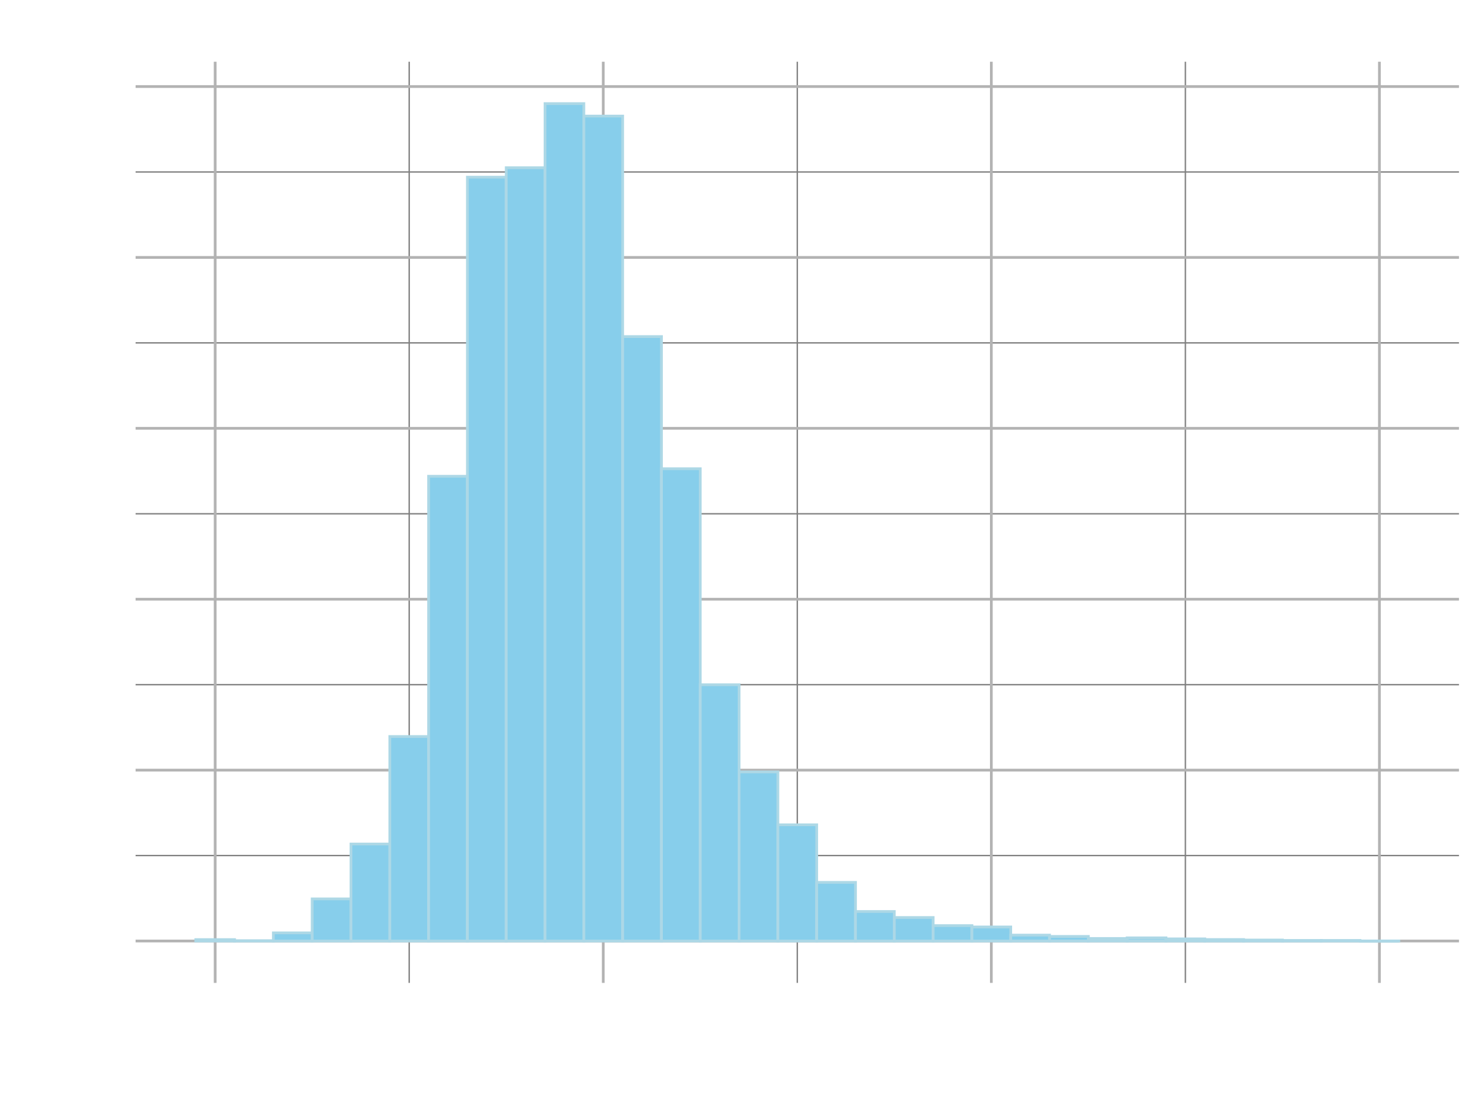
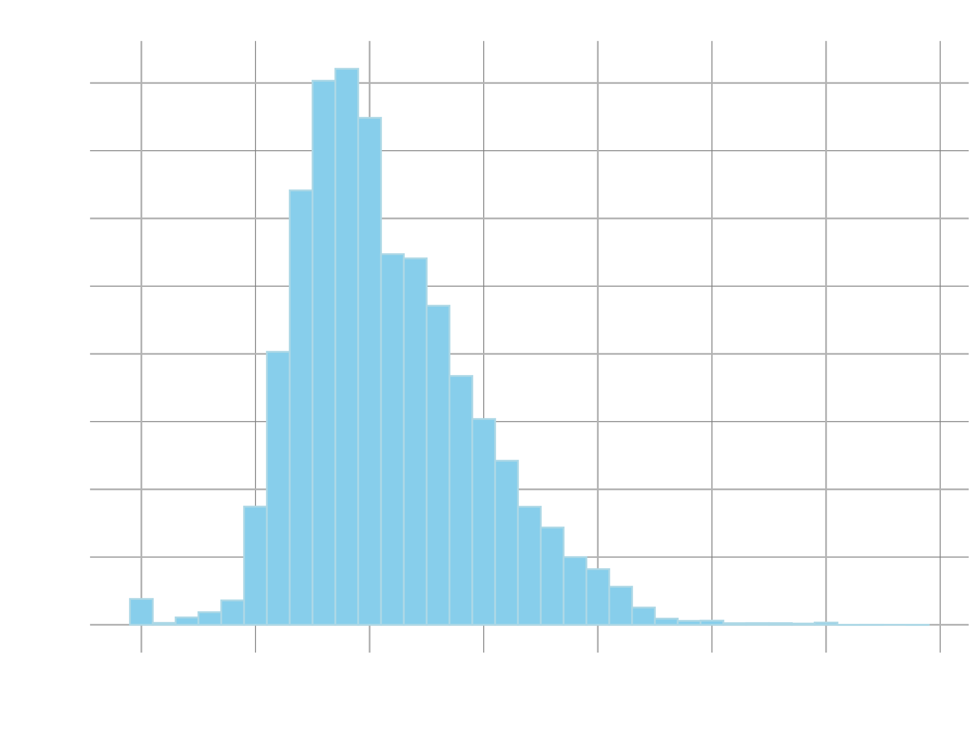
Rental Composition: Price & Property size Distribution

Slide 6
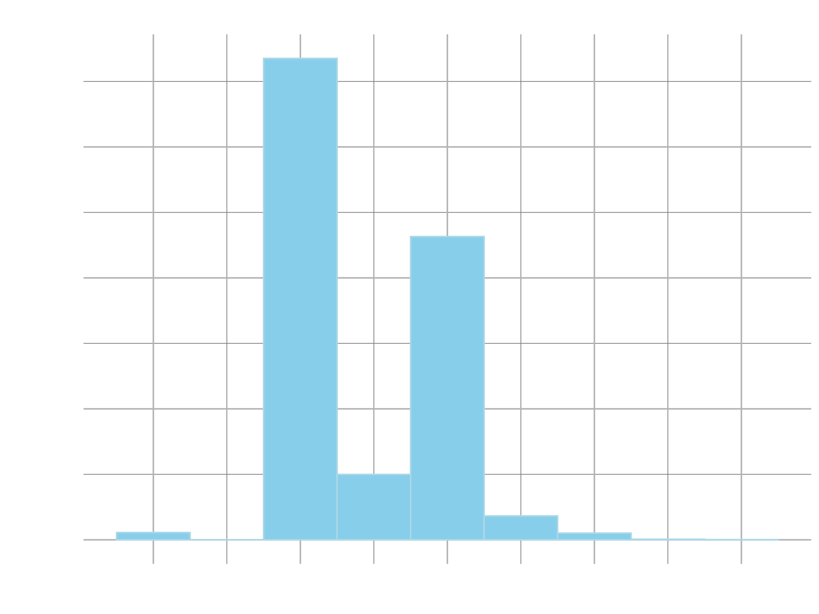
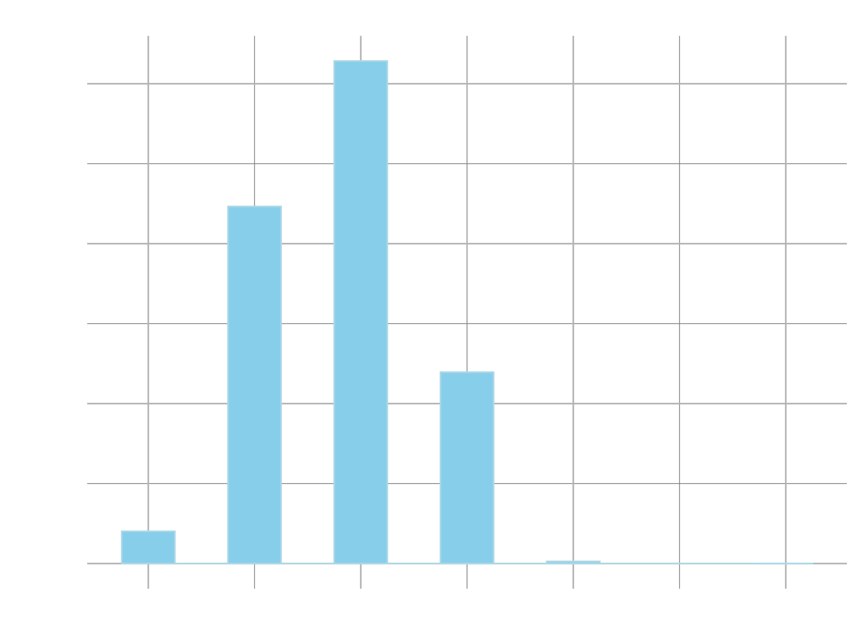
Rental Composition: Bedroom & Bathroom Distribution

Slide 7
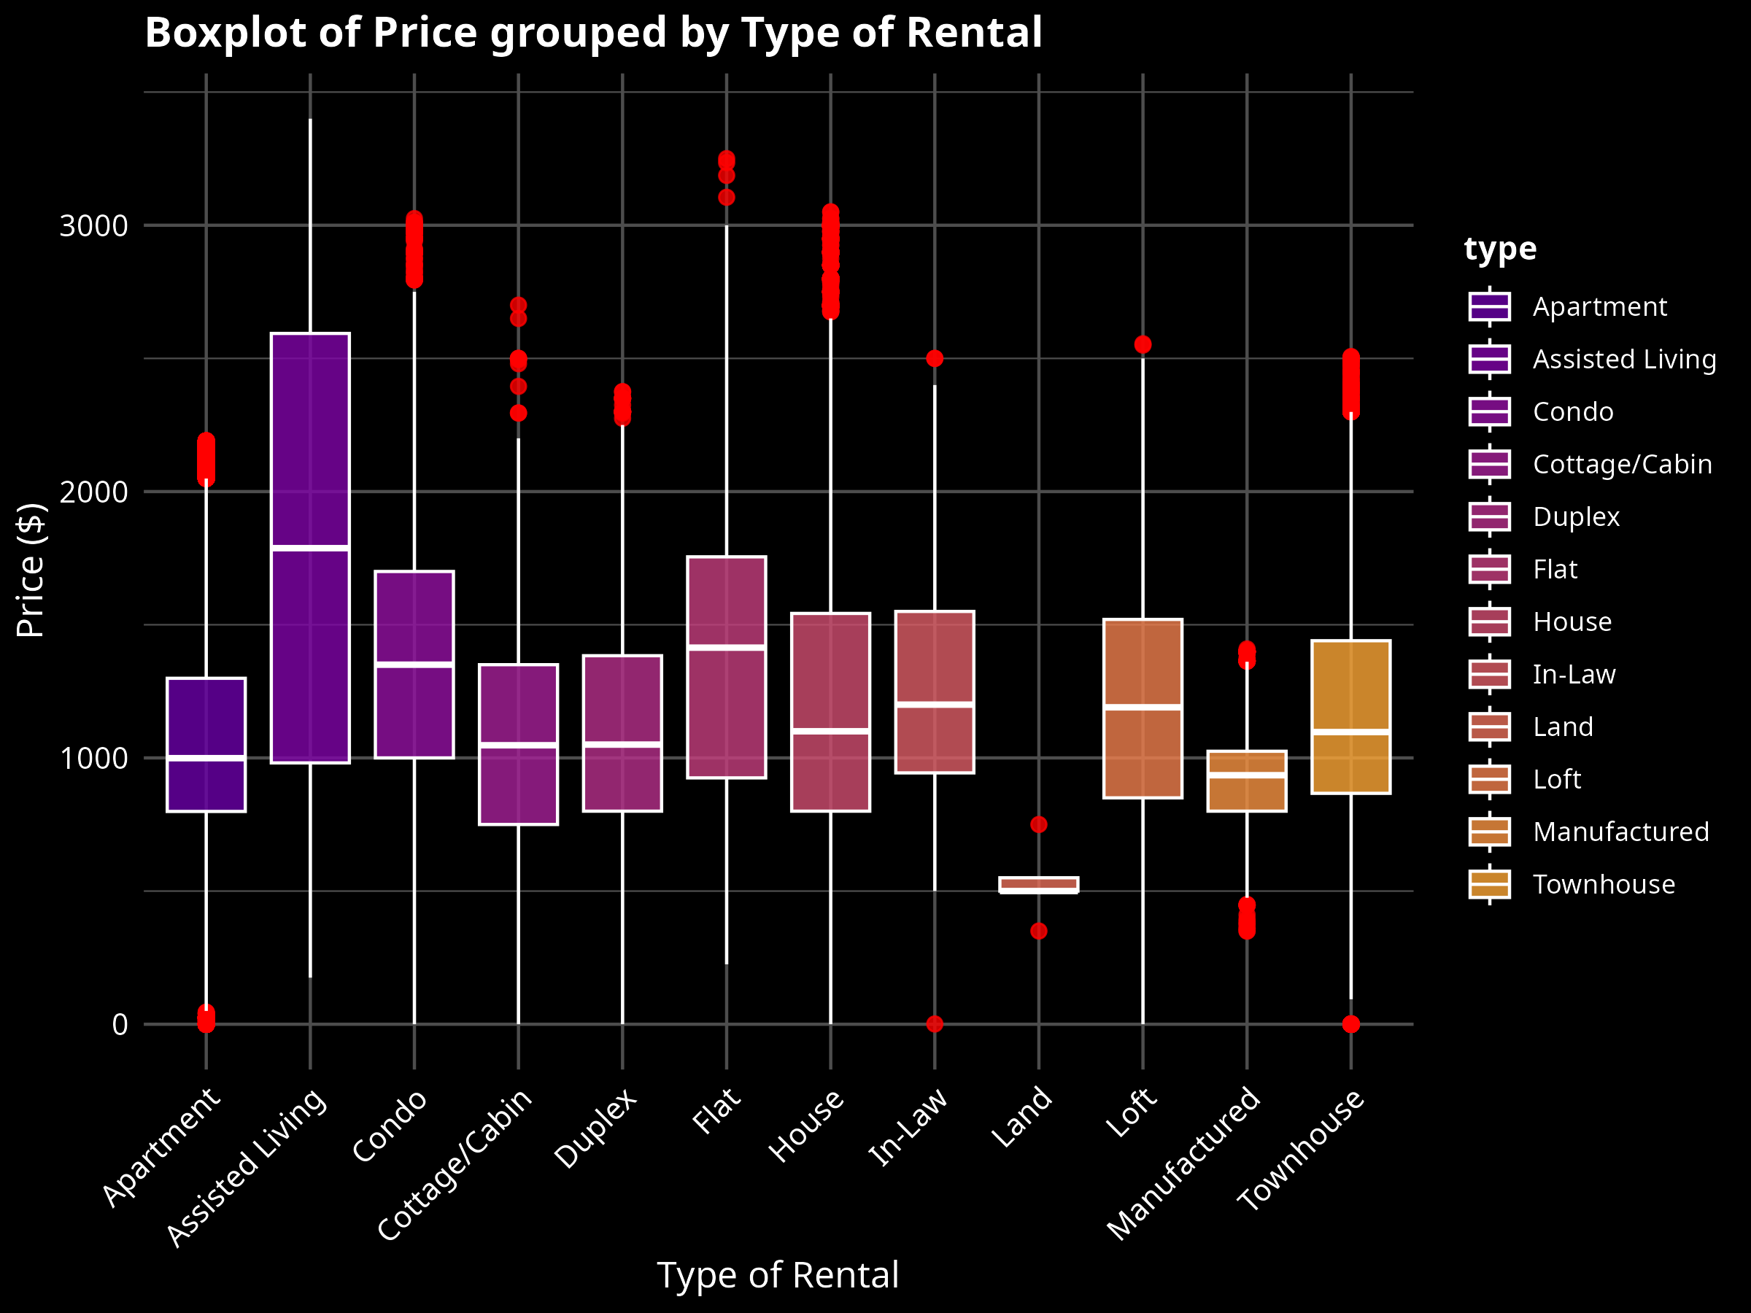
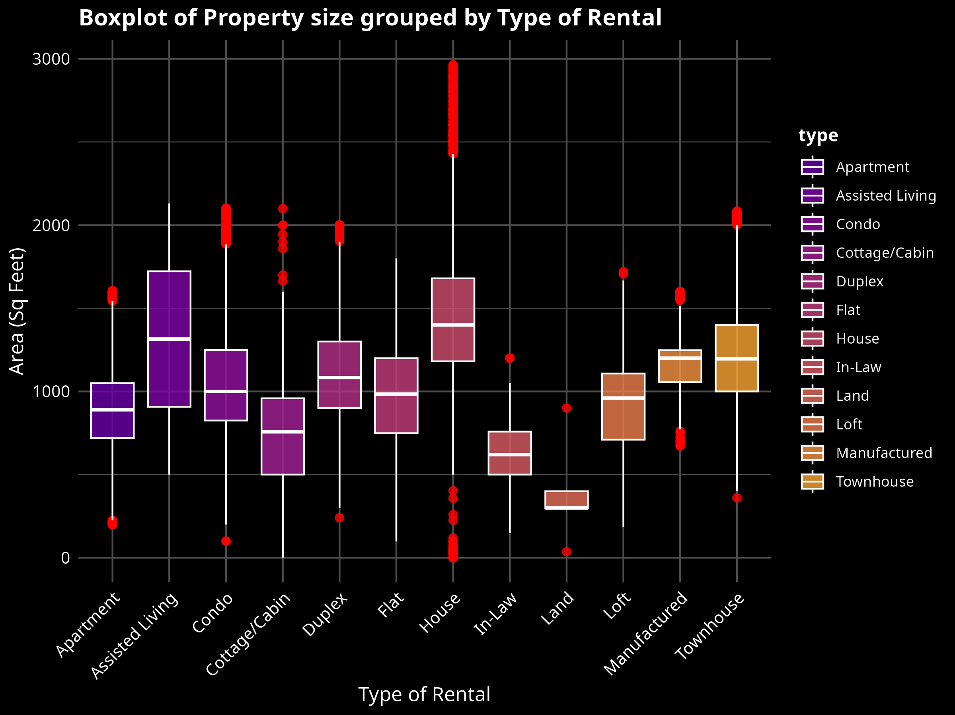
Rental Composition: Boxplots

Slide 8
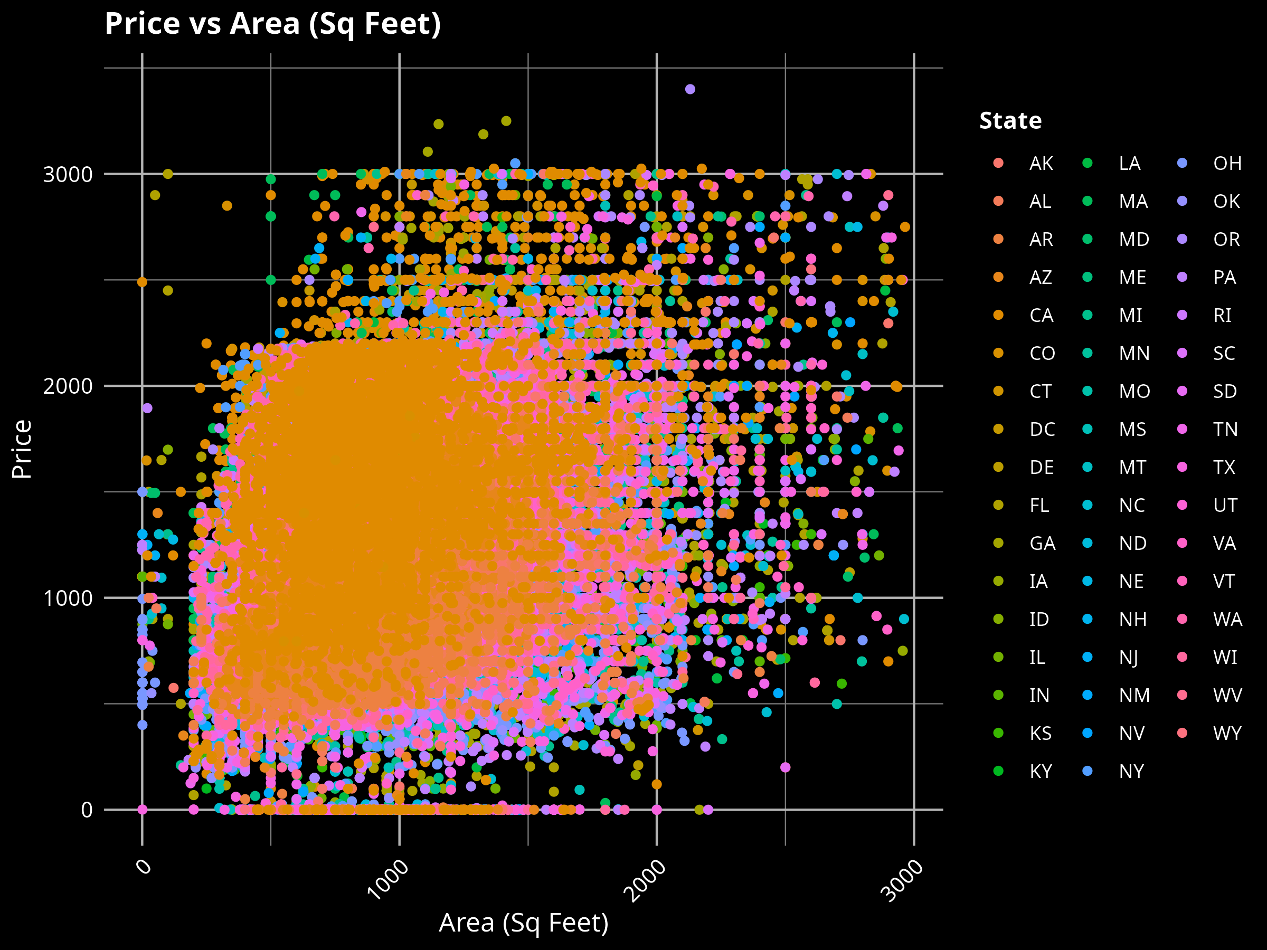
Rental Composition: Price vs Property size

Slide 9
Amenities
Pet Friendly
A
B
Furniture and Laundry
F
C
Smoker Friendly
Parking Availability
Wheelchair Accessible
E
D
EV Charging Infrastructure

Slide 10
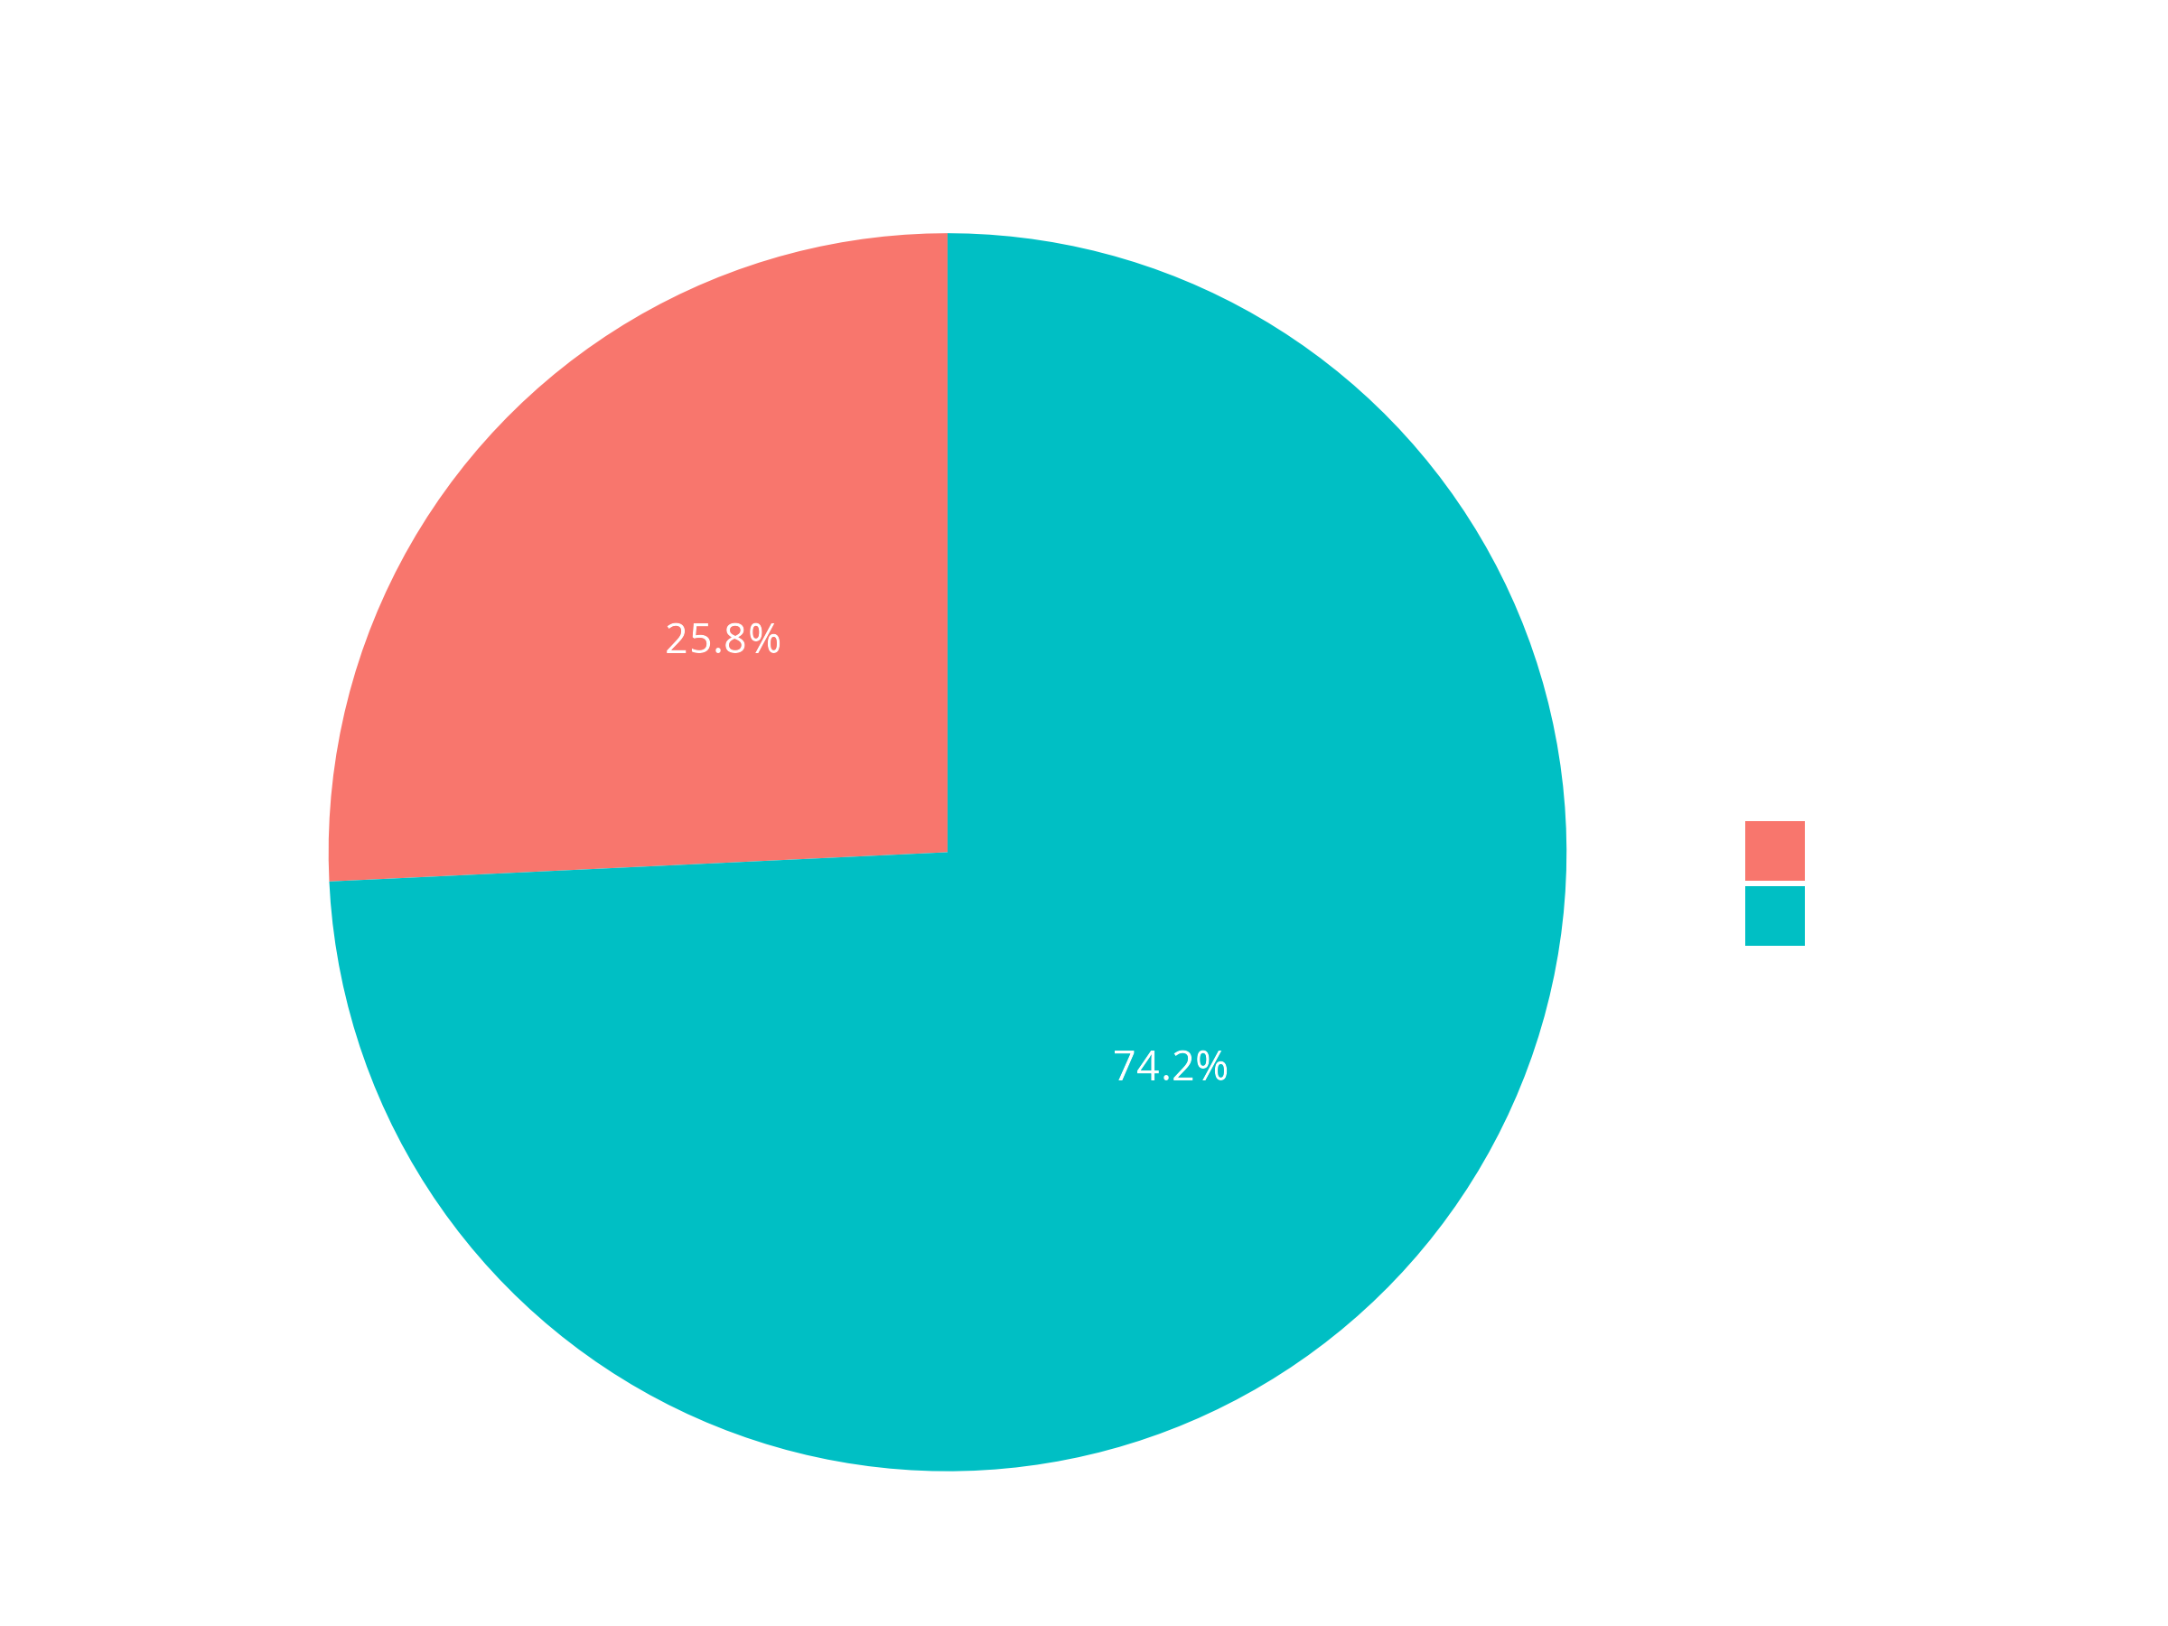

Amenities: Pet Friendly

Slide 11
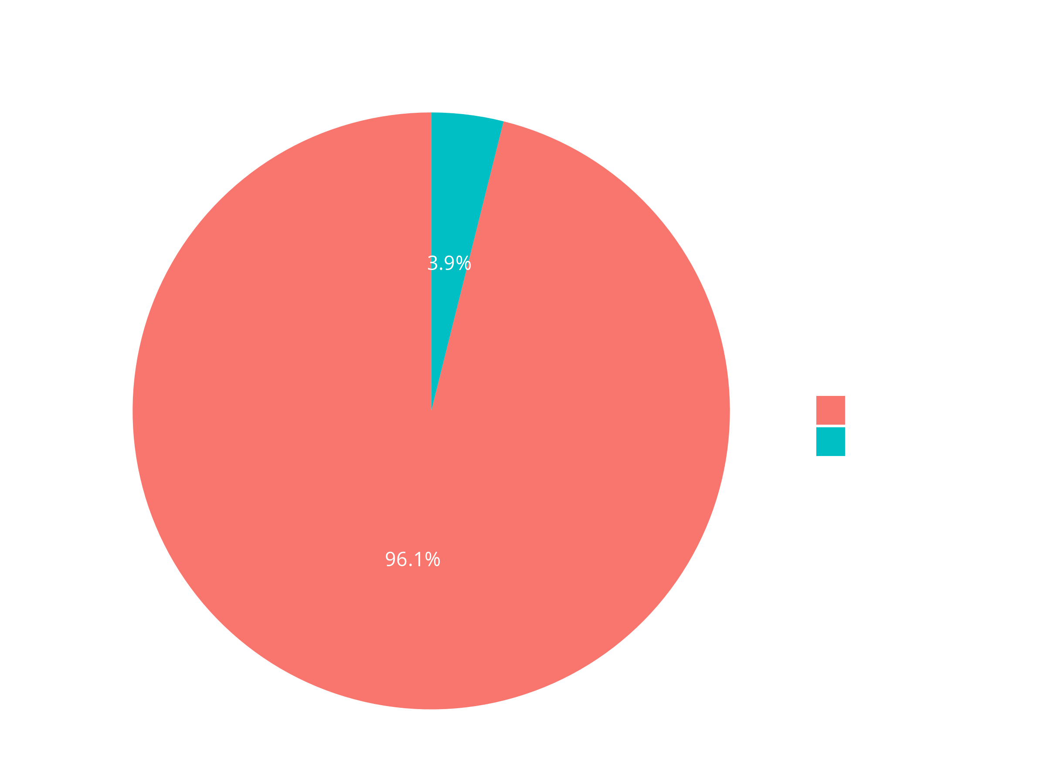
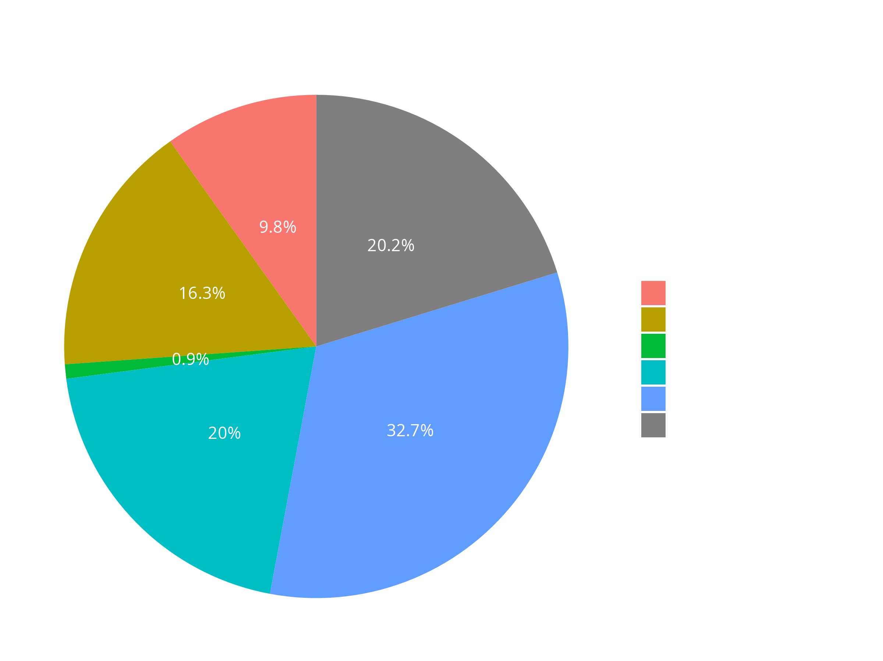
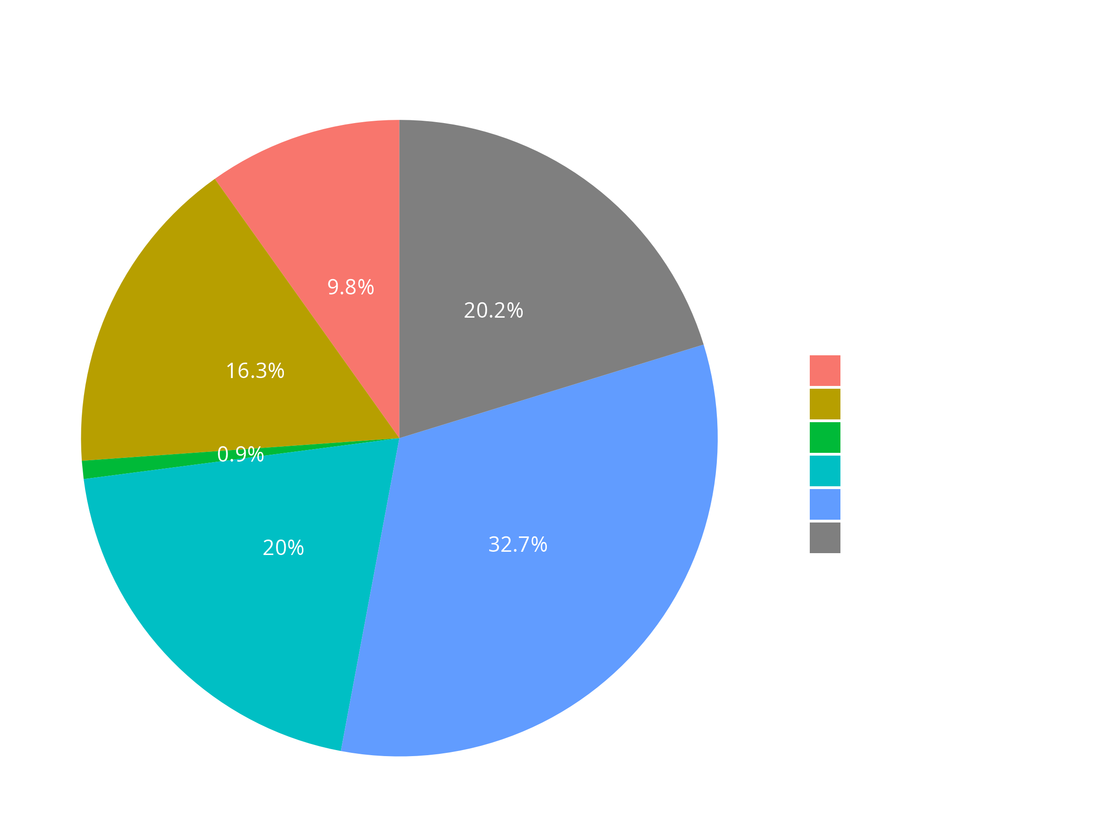
Amenities: Furniture & Laundry

Slide 12
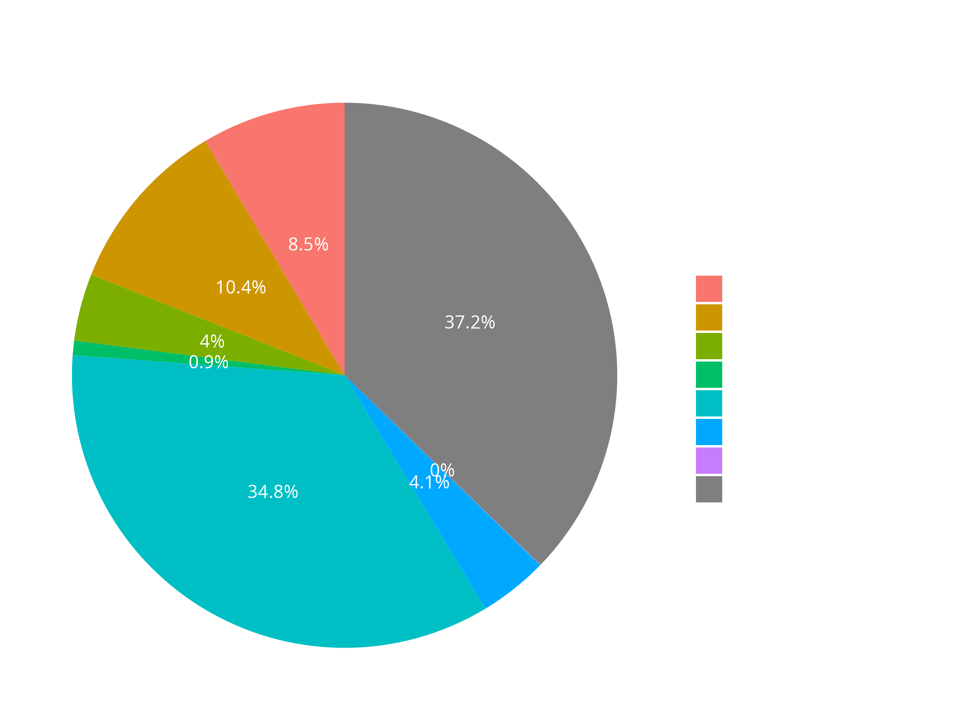
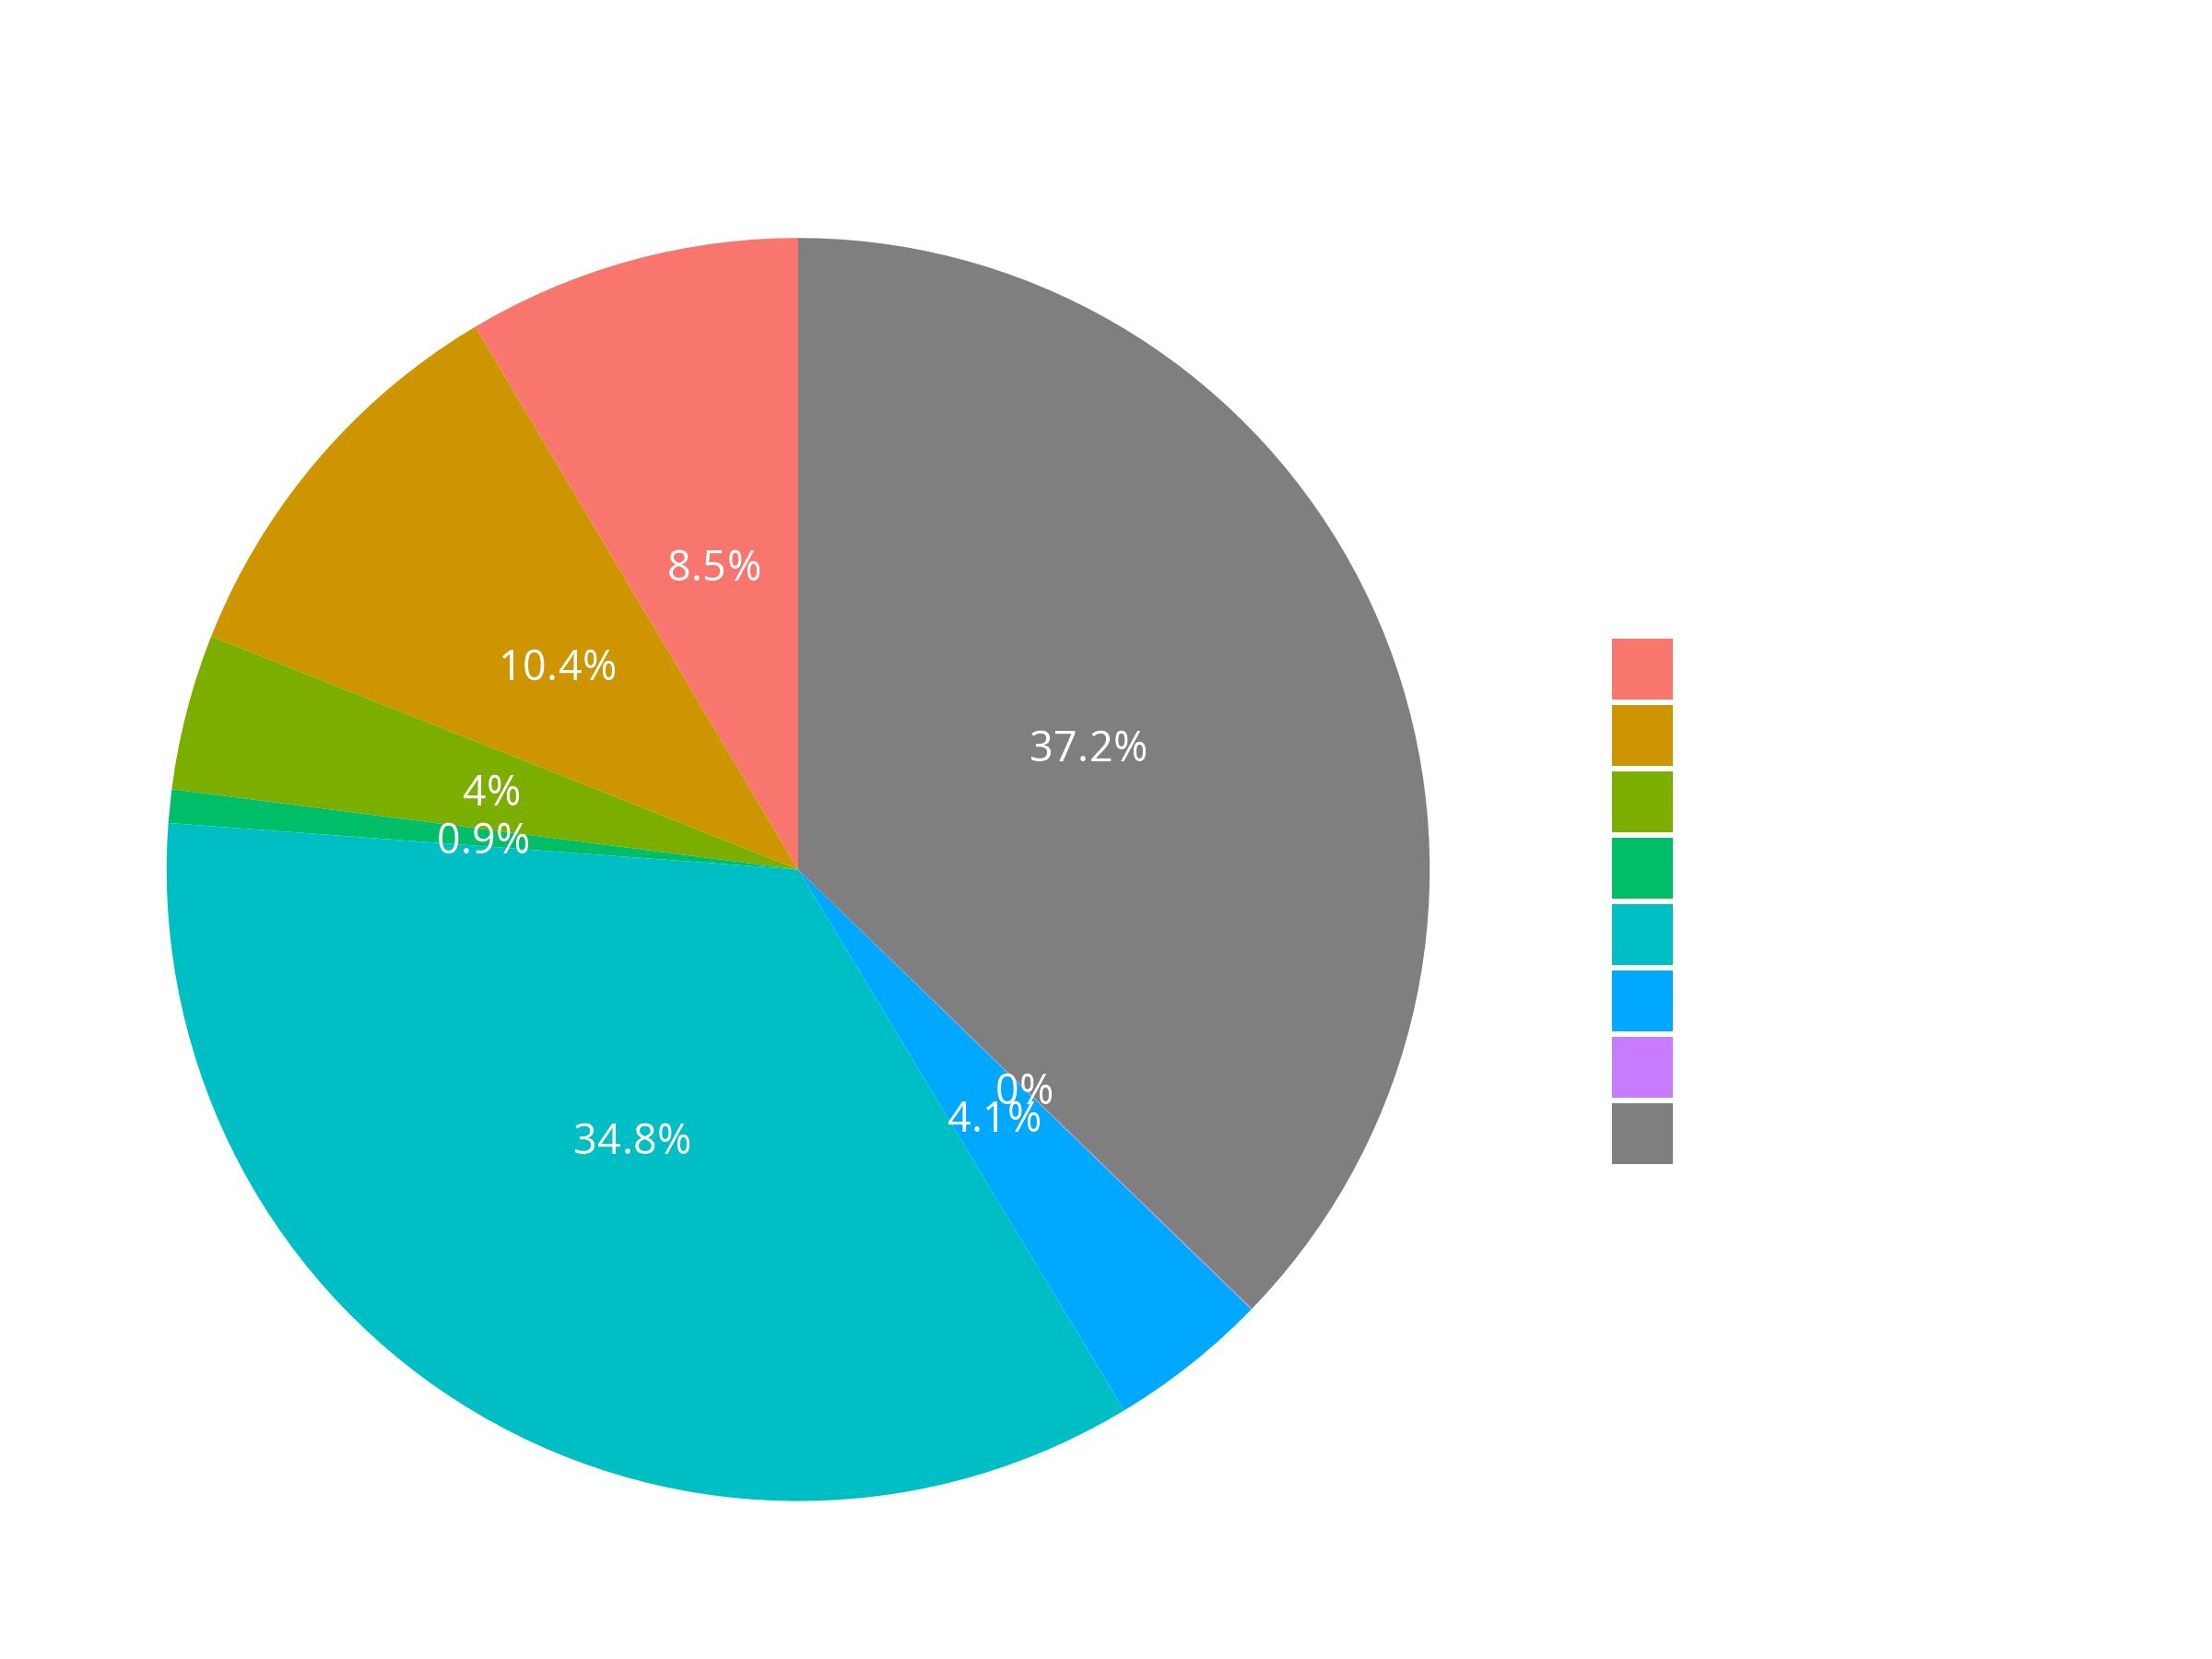
Amenities: Parking Availability

Slide 13
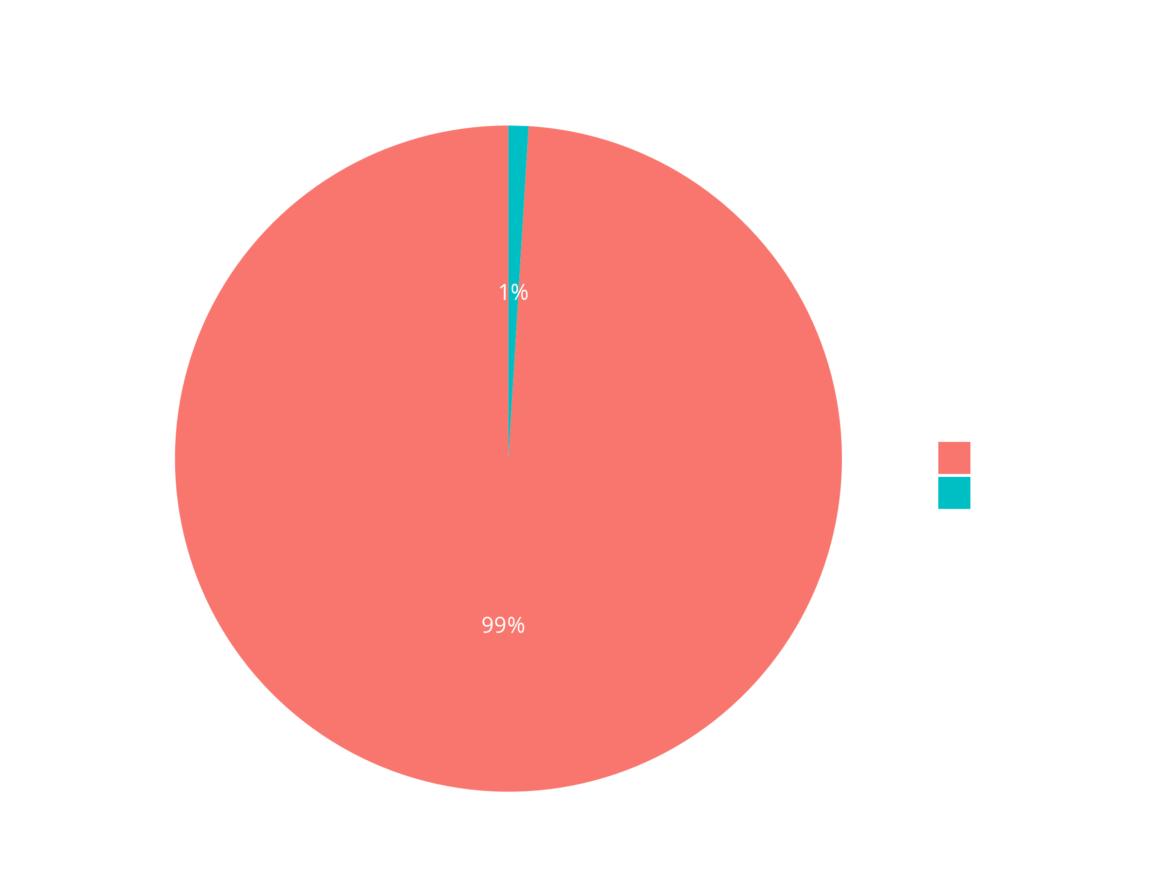
Amenities: EV Charging Infrastructure

Slide 14
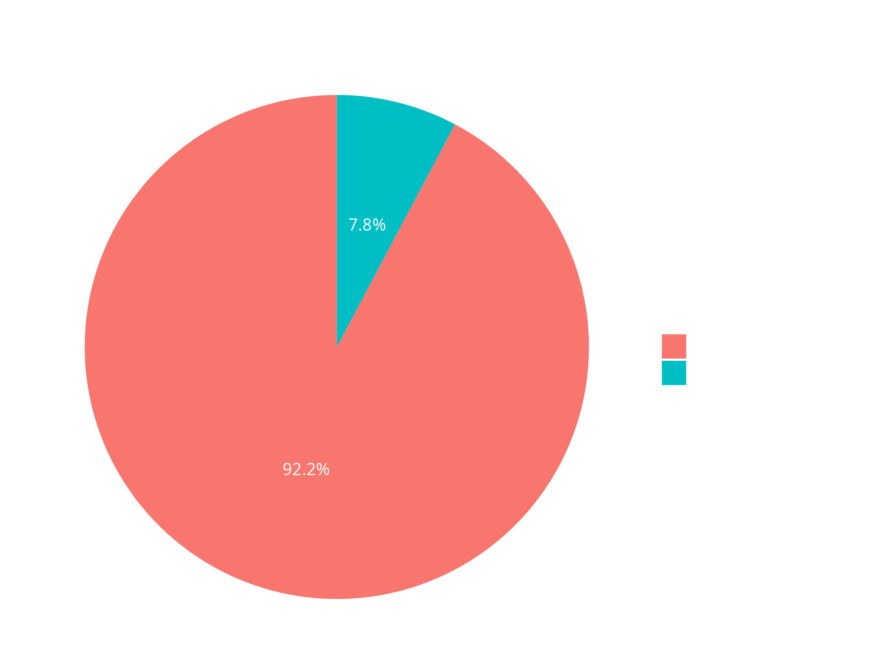
Amenities: Wheelchair Accessible

Slide 15
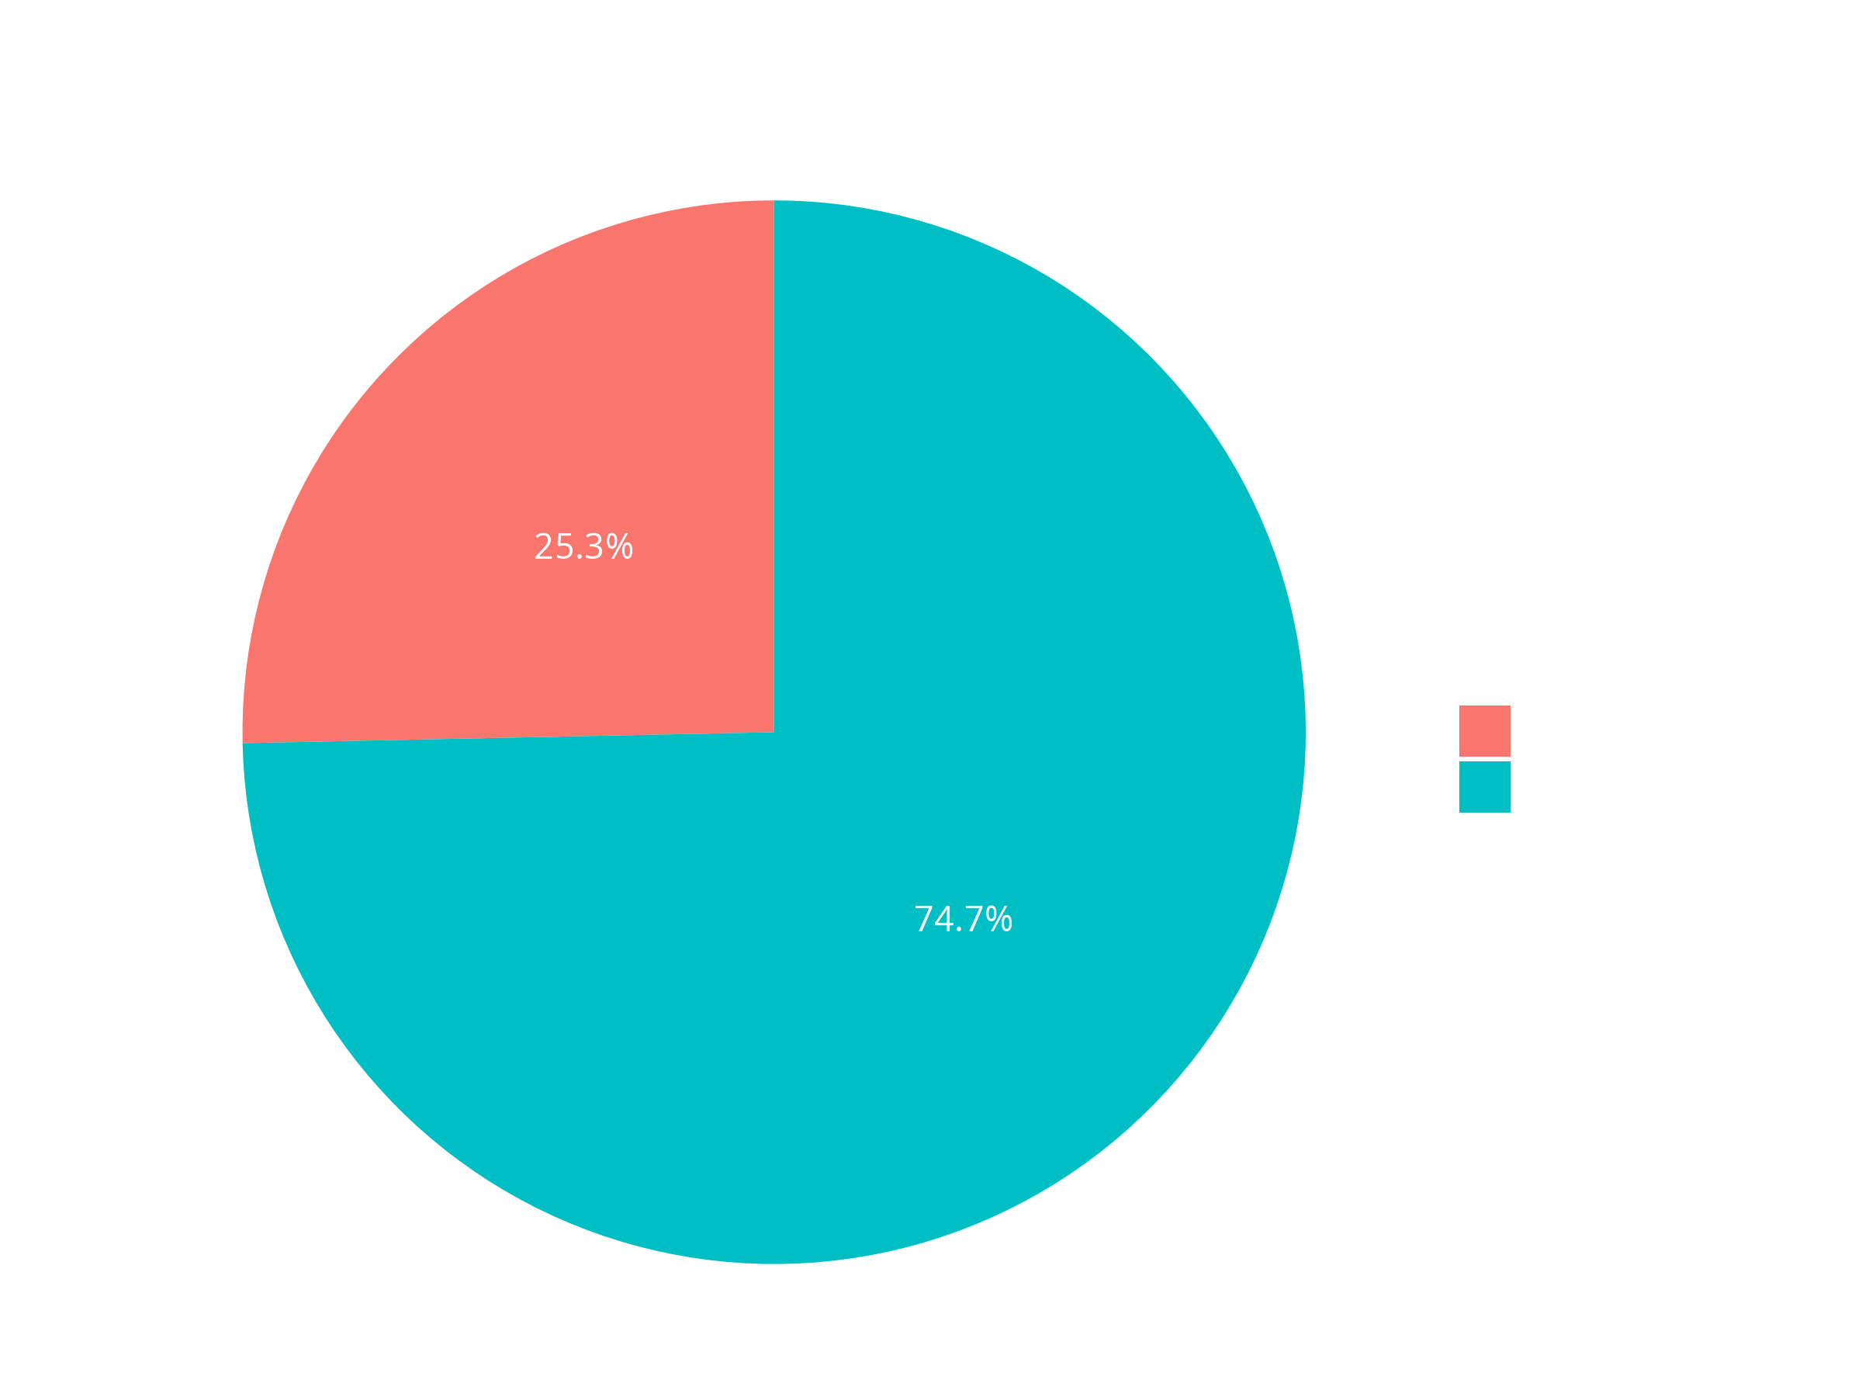
Amenities: Smoker Friendly

Slide 16
Inference?, Observation?
The Big Picture:
Price
Correlation
The Big Picture: Size
“Price” vs “Value”

Slide 17
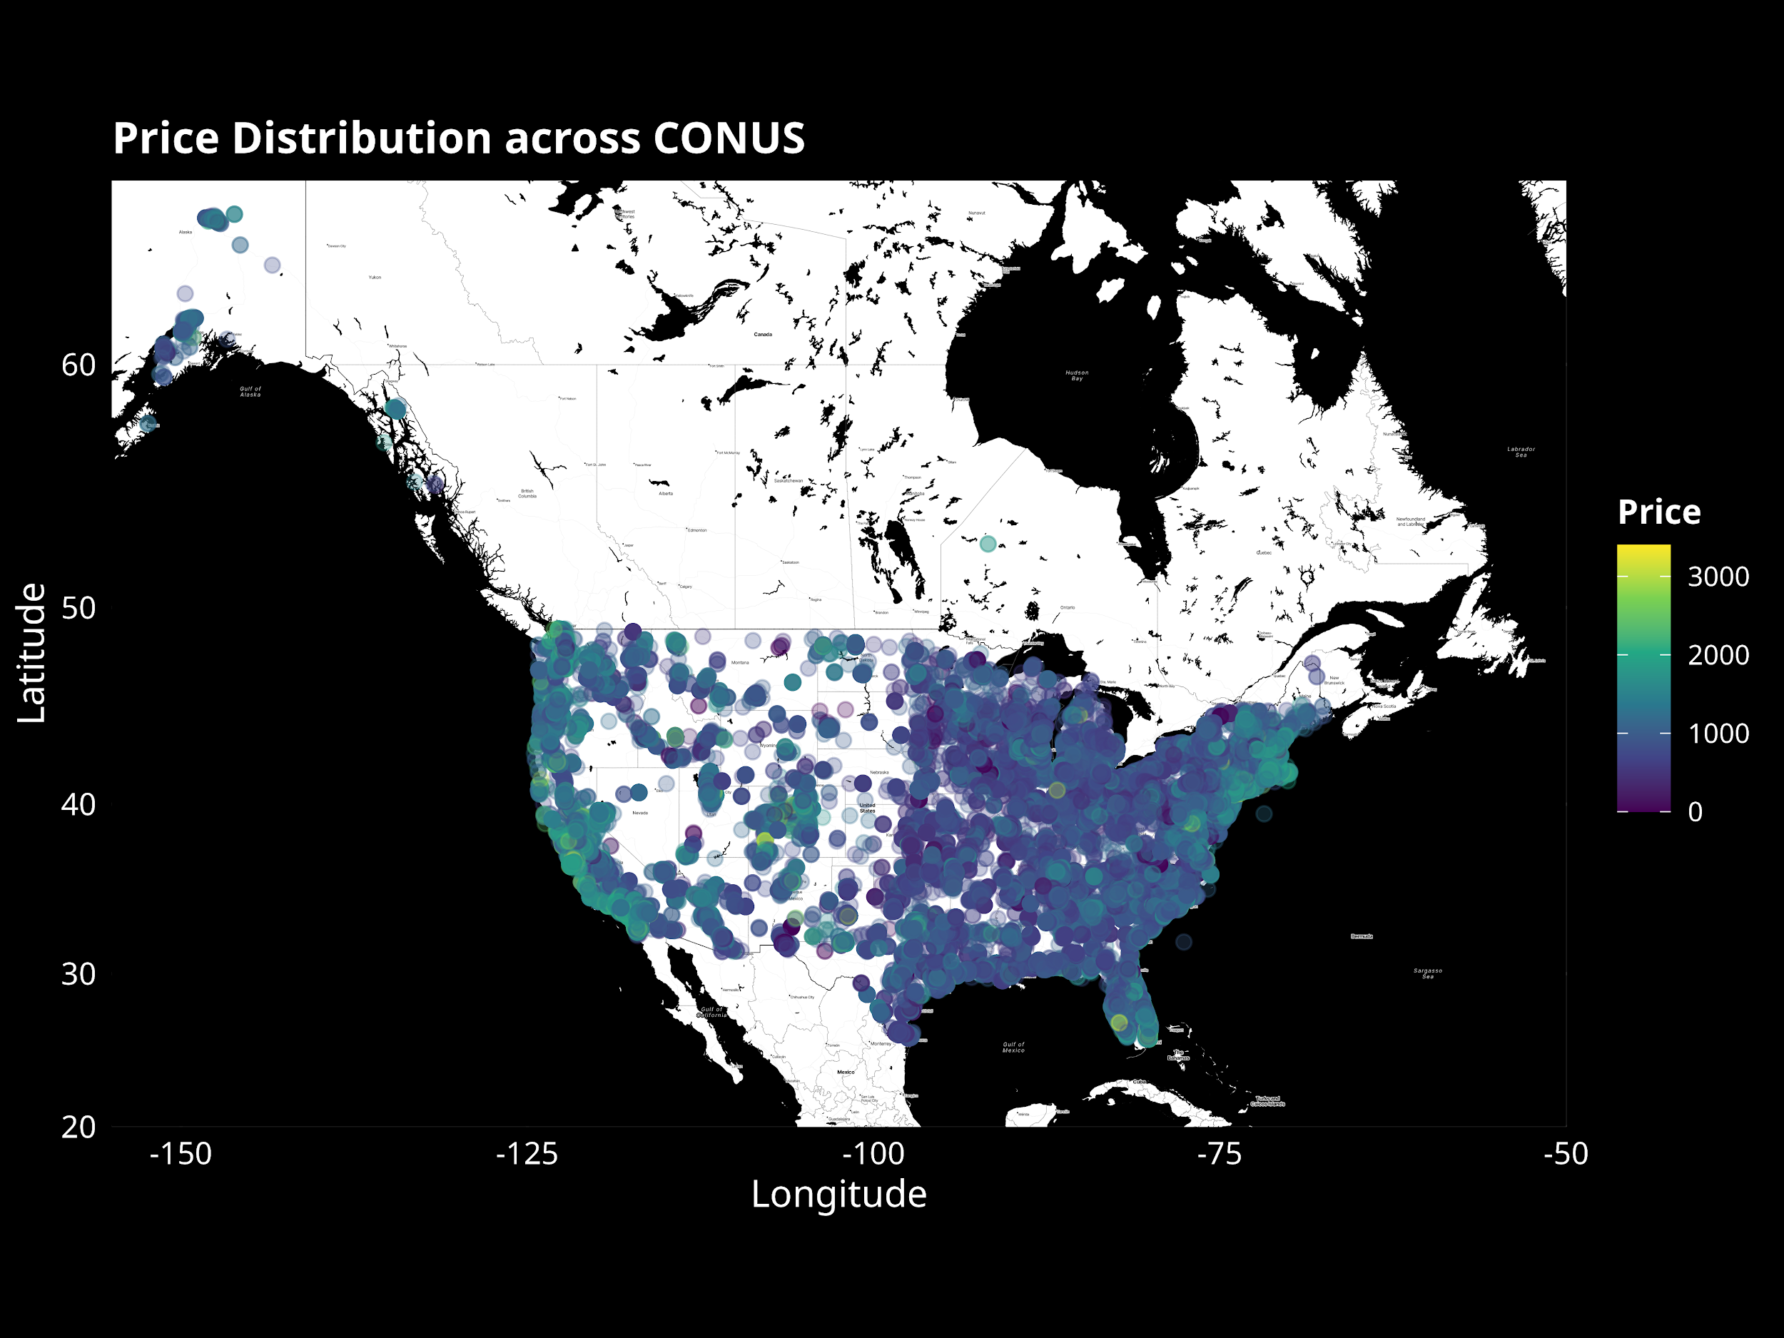
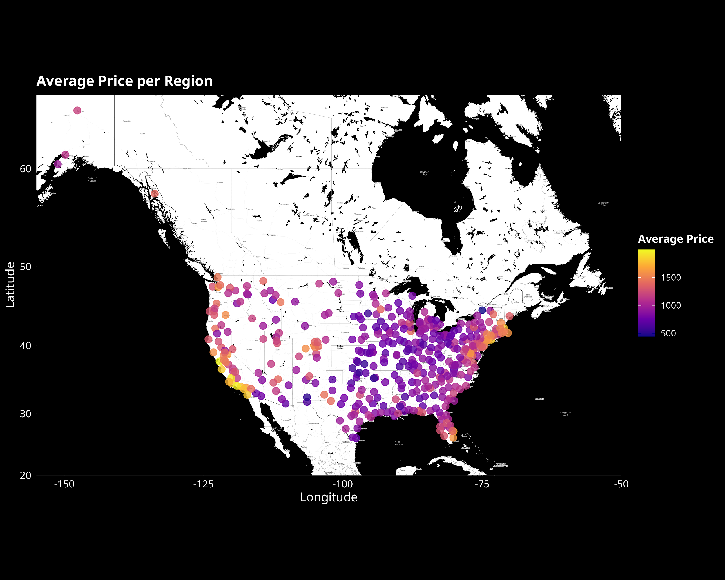
The Big Picture: Rental Prices Across CONUS

Slide 18
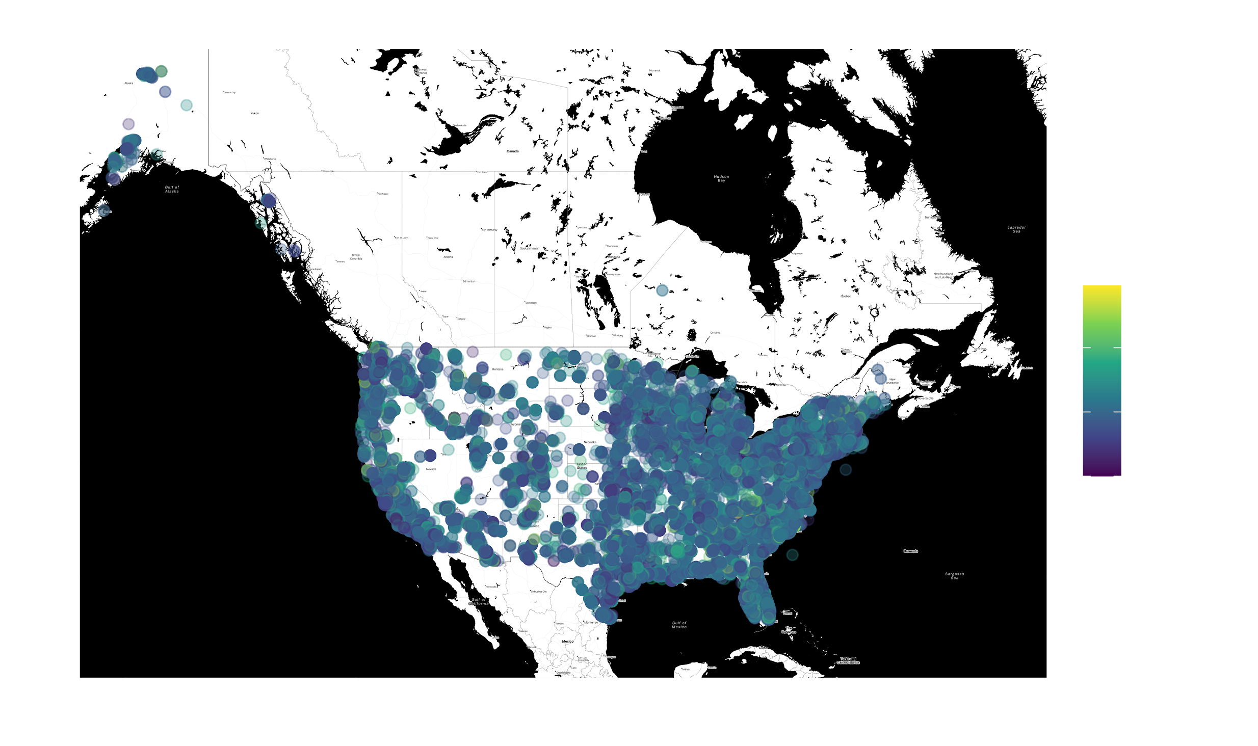
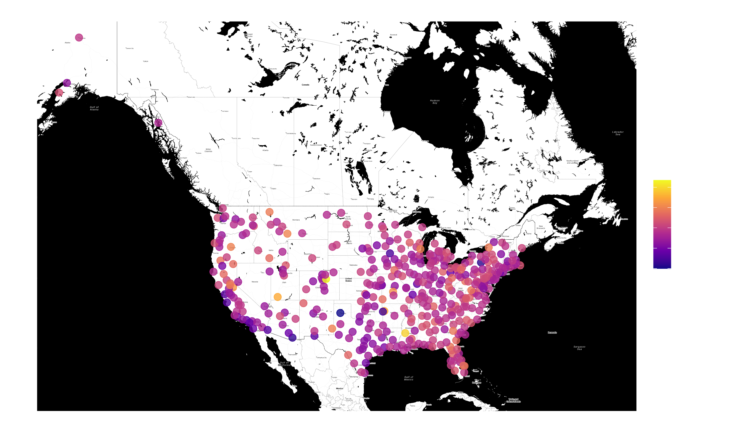
The Big Picture: Property Size Across CONUS

Slide 19
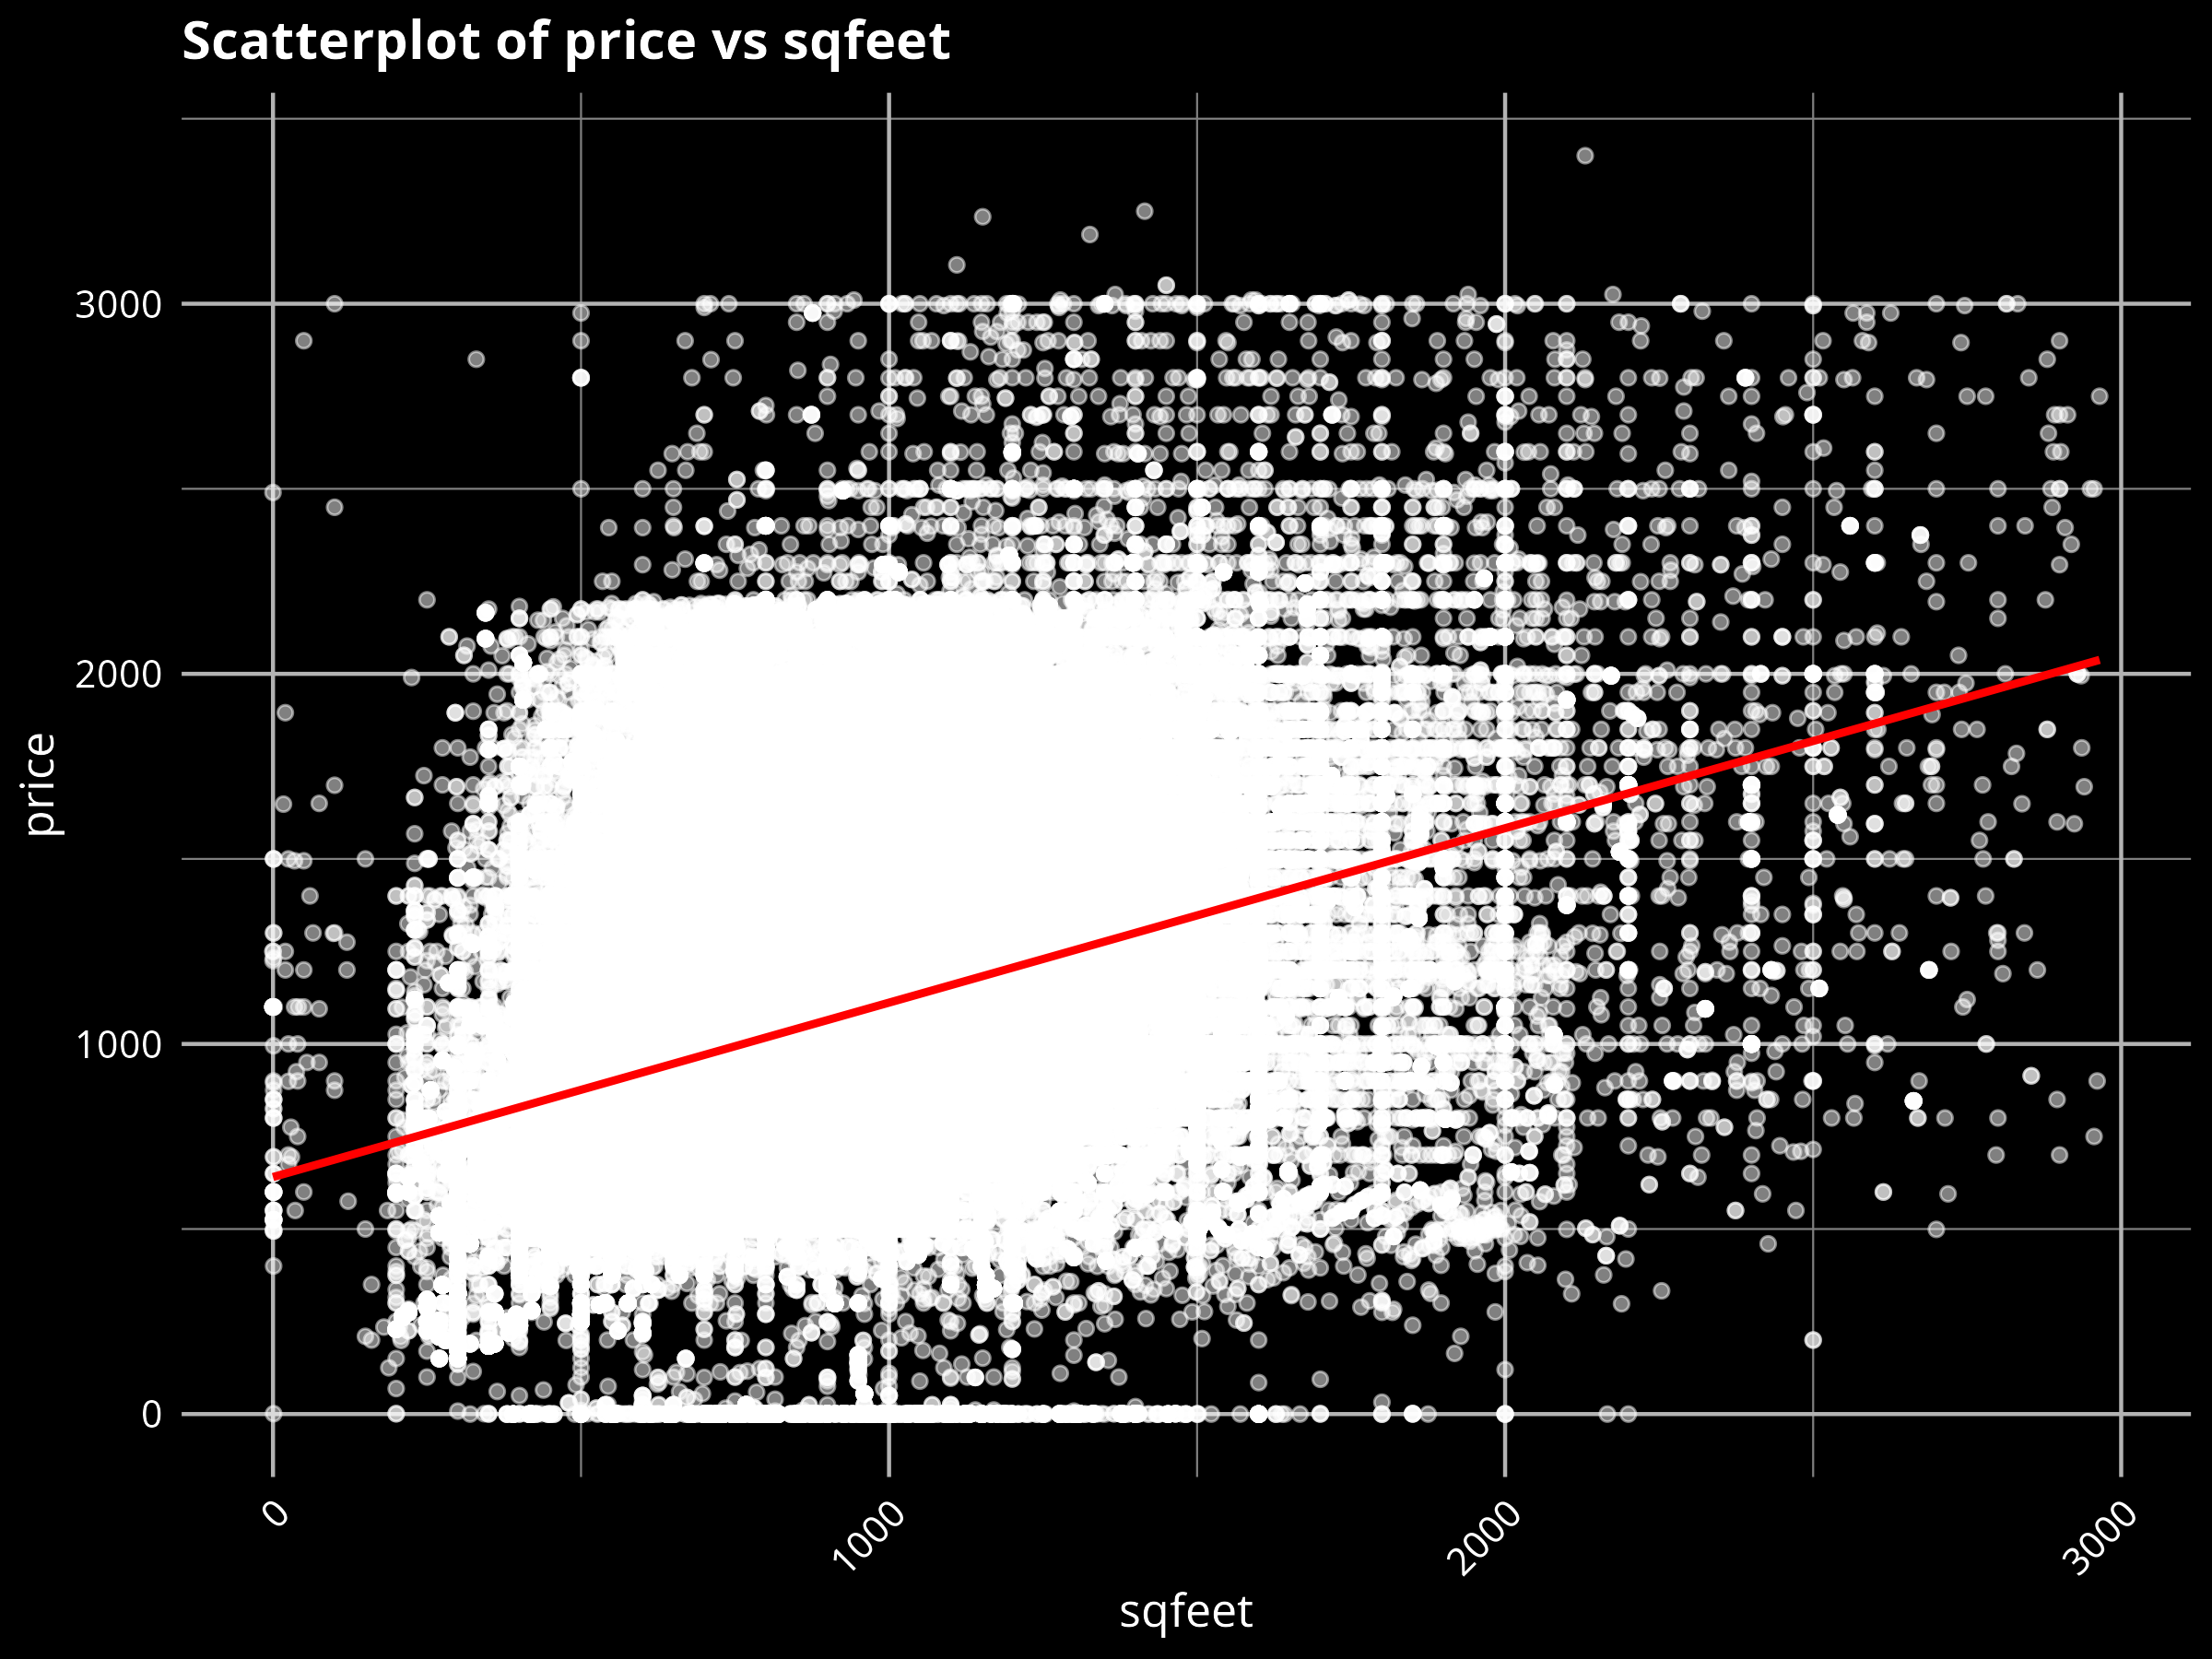
Correlation: Price vs Property size

Slide 20
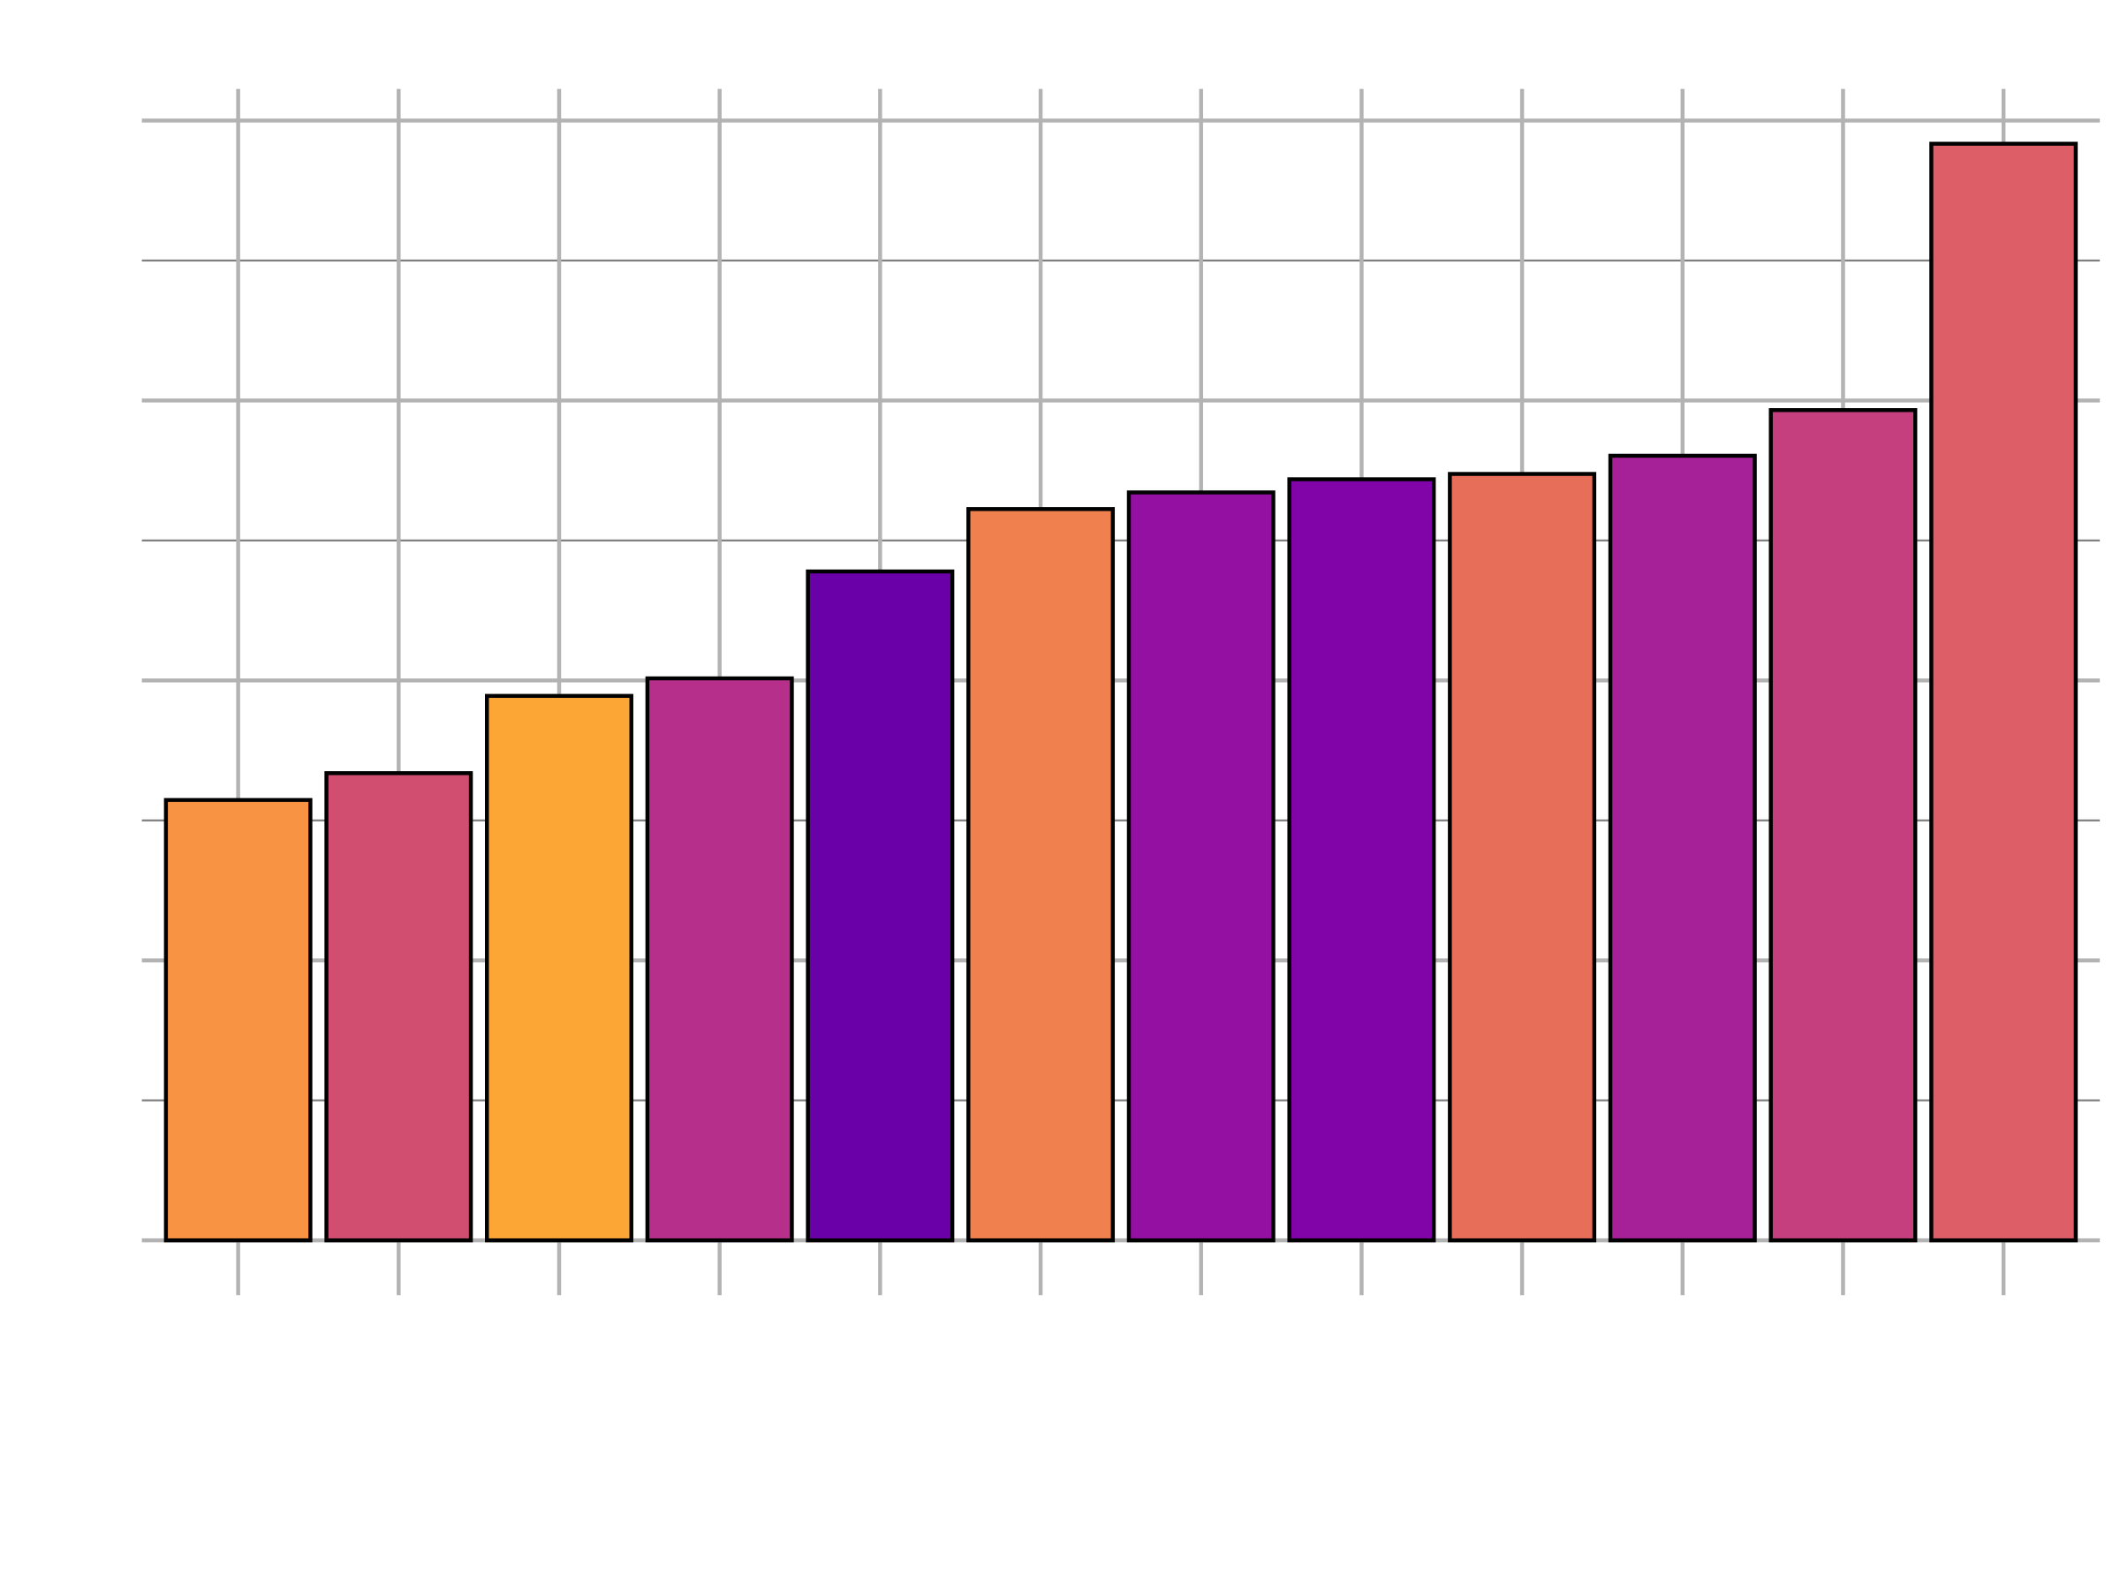
Avg Price vs Avg Property size

